Slide 1

Welcome to Reception
Langstone Academy is a community of learners who strive and aspire to ‘be excellent together’. As learners, we seek to challenge and question the world around us to develop the skills to be lifelong learners.
RM: Mrs Mitchell (Year Leader)
RV: Miss Vickers
RB: Mrs Bartlett

Slide 2
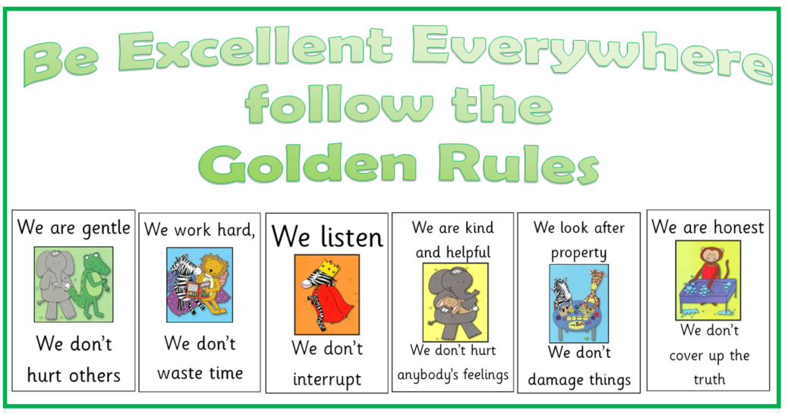
Golden Rules
At Langstone, we follow the six Golden Rules to make our school a safe and happy environment. We are excellent together.

Slide 3
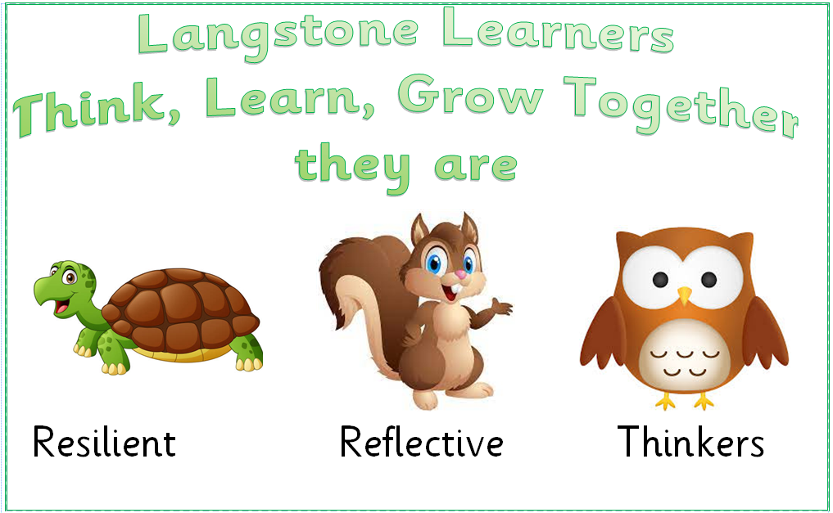
Langstone Learners
At Langstone, we aim to develop learners who are reflective, resilient thinkers and challenge themselves in all areas of learning both in and out of school. We believe that children need to develop a skills set that enables them to achieve this and become confident learners. When we see the children displaying one of these learning powers we will award them a merit.

Slide 4
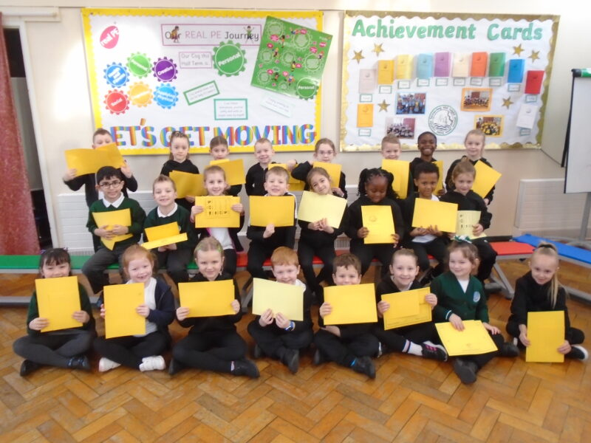
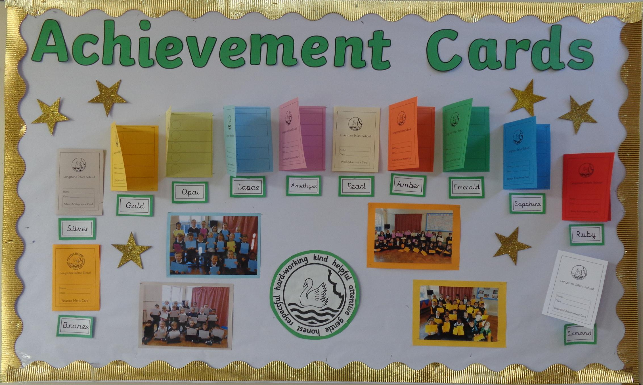
Merits
What is a Merit Award?
Children are given merits in school for many reasons. These can include following the Golden Rules, completing a piece of amazing work by being a resilient, reflective thinker or for being a kind friend.
Every time a child earns a merit, the reason is recorded on their merit card. When the ten slots are full, they attend an Achievement Assembly to celebrate their success.
Parents are invited along to these special assemblies and each child is called to the front to receive their certificate and one of the merits is read from the card. The children are given a certificate and move onto the next colour of merit card.
A special Achievement Assembly is held regularly for pupils who
have completed their merit cards and parents and carers are
invited to join us for this.

Slide 5
Our Topics
Topic | Subject
Getting to know you | All about me My family
Our Celebrations | Our celebrations Harvest/Nativity/Christmas
Helpful Heroes | Helpful Heroes - Real life heroes Supertato
Once Upon a Time | Traditional Tales Healthy Eating
All Creatures Great and Small | Minibeasts Norman the slug with the Silly Shell
Wonderful Water! | Planting/growing Hooray for Fish! Rainbow Fish

Slide 6



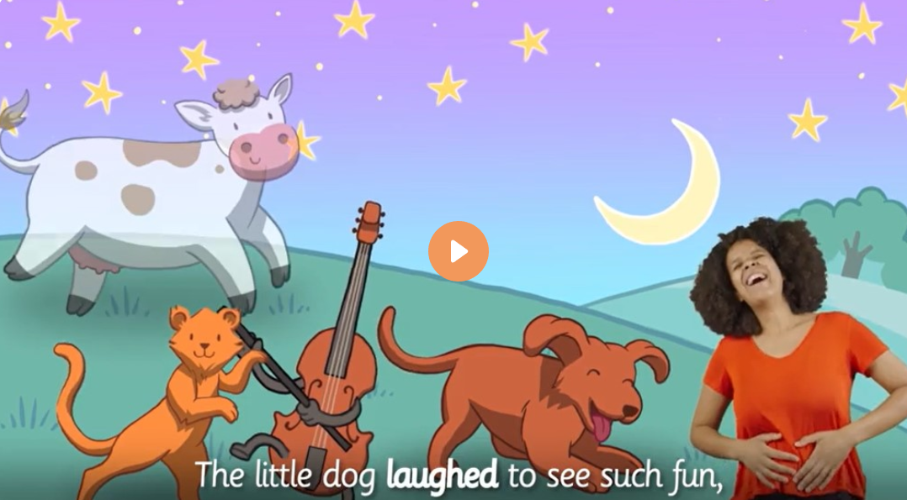


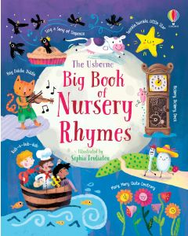

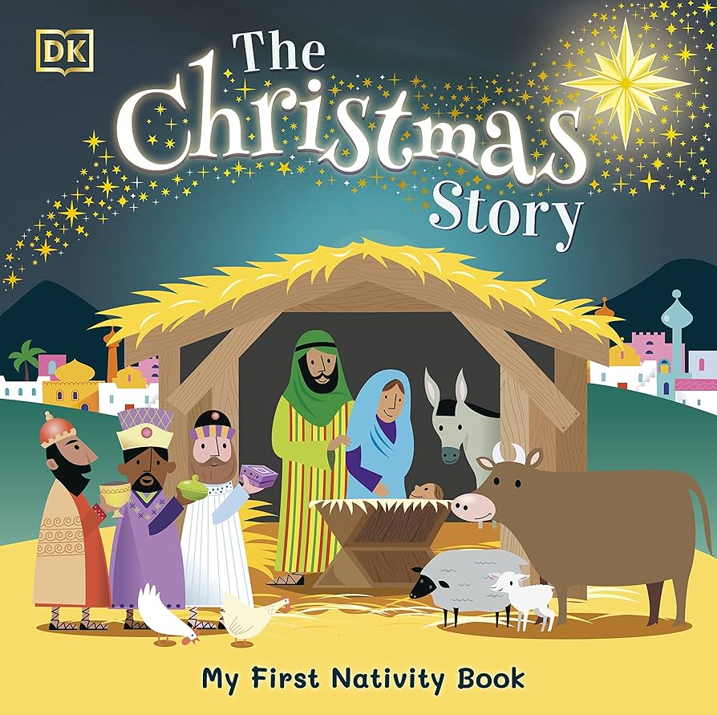




Communication and Literacy
When | Coverage
Autumn | nursery rhymes - to develop language and awareness of sounds The Christmas Story - simple story telling Read With Me Stories - instilling a love for reading fine motor activities - to enable children to use small tools letter formation - to encourage the correct letter formation
Spring | nursery rhymes - to develop language, awareness of sounds and support reading Supertato - simple story re-telling non-fiction texts - for children to follow their interests empathy texts - learn about my emotions and feelings simple word writing - to hear sounds in words in order traditional tales - engagement with stories
Summer | nursery rhymes - to support phonics teaching, reading, writing and communication non-fiction texts - for children to follow their interests Hooray for fish - simple sentence writing and re-reading Rainbow Fish - simple sentence writing and re-reading

Slide 7
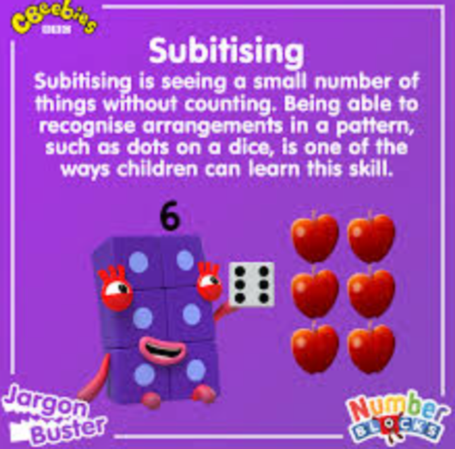
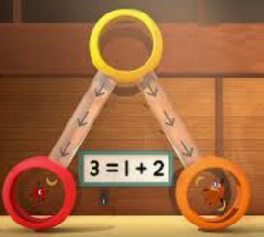

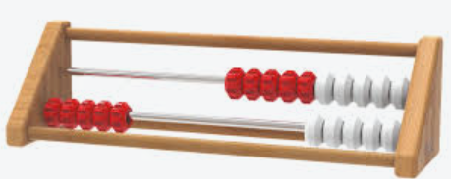
Maths
When | Coverage
Autumn | number and place value 1-5 subitise to 5 count to 5 recognise numerals to 5 order to 5 represent up to 5 comparison focus on whole and part shape, space and measure is taught through continuous provision
Spring | number and place value 6-9 subitise up to 5 counting recognise numerals up to 8 order up to 8 represent up to 8 doubles, odds and evens comparison focus on; more than, fewer than, equal to, wholes and parts shape, space and measure taught through continuous provision
Summer | number and place value 0-10 subitise to 5 and 6 counting larger sets recognising numerals ordering up to 10 composition up to 10 number bonds to 5 Rekenrek up to 10 shape, space and measure taught through continuous provision

Slide 8
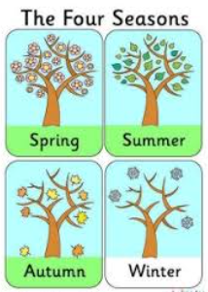
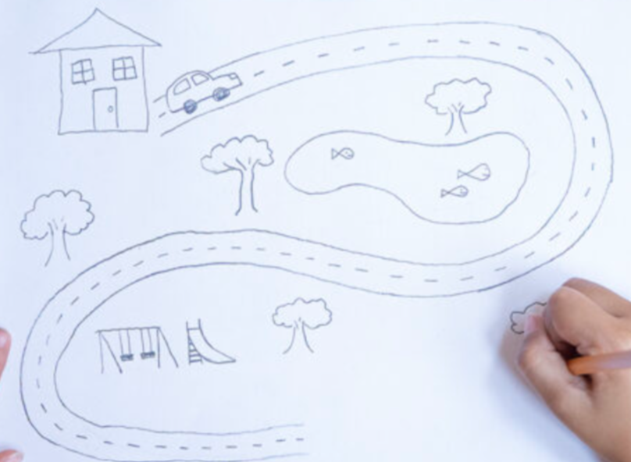
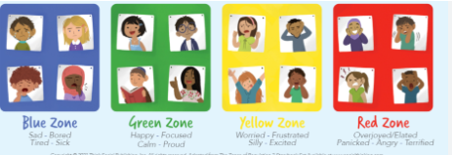
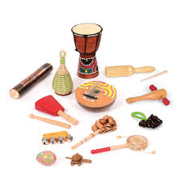

Understanding the World
Personal, Social and Emotional Development
Expressive Art and Design
Coverage
simple map skills commenting on familiar images from the past recognising where I live knowing people have different beliefs naming familiar people seasons comparison of stories and characters exploring the natural world
When
Coverage
expressing feelings learning how others feel looking after my health relationships and relational circles learning resilience considering perspectives of others
Coverage
using basic tools (scissors) engaging in singing and dancing re-telling stories through play exploring music create collaboratively

Slide 9


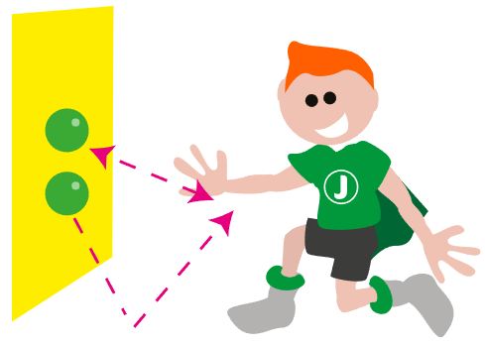

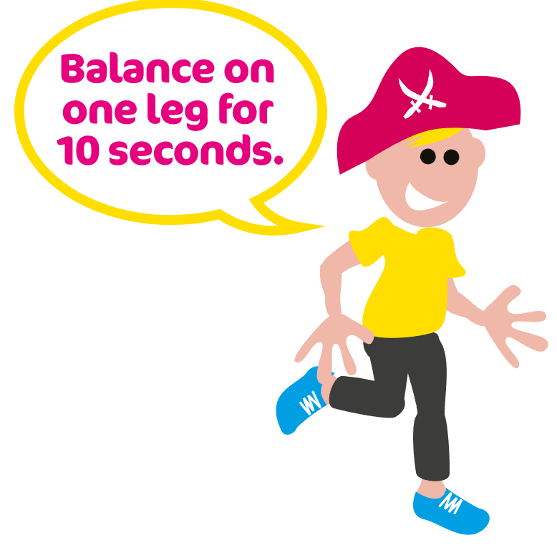


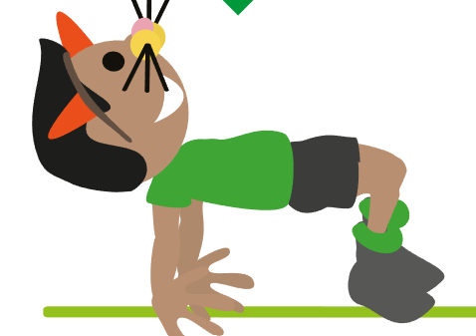
PE
PE in EYFS
 | In PE, we learn how to follow instructions, share and take turns and perform some skills with control and link movements. We work through a variety of cogs (left) which have a different focus and have a different theme throughout the year such as jungle, space and circus. We will also be learning to: balance - we learn to stand on one leg floorwork - we learn to balance and put movements together coordination - we learn to send and receive
PE Days
Our PE day is a Tuesday
Please arrive at school in your PE kit. Children will remain in their PE kit for the day.
PE uniform
Black shorts or leggings
White t-shirt
Black tracksuit bottoms
Black jumper and trainers.
Please remember:
- No jewellery can be worn during PE sessions, this includes any earrings, even studs. If your child cannot remove their own stud earrings for these sessions, they will need to have them removed at home or covered over with medical tape on PE days. Parents should cover the earrings using tape from home. Thank you.
-Watches must not be worn so we ask you not to send your child in with a watch on their PE days.

Slide 10

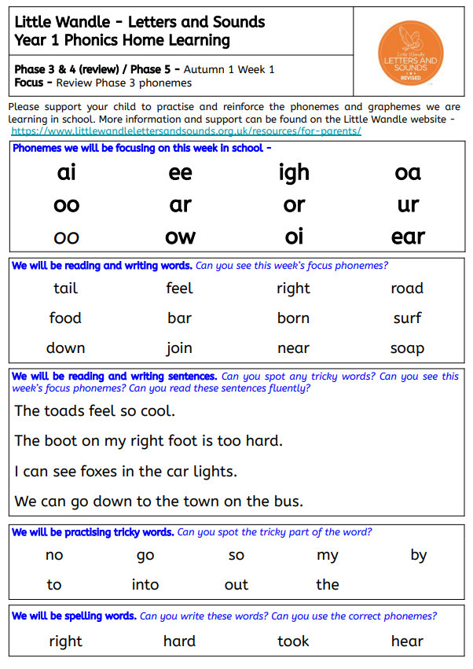
Home learning
Activity
Daily reading | We will send home three books in your child’s book bag. A book that is closely matched to their phonic ability, a ‘challenge’ book that they may need some additional support with and a ‘love of reading’ book for you to share with your child. Please make a note of any reading your child does or any books that you share together so we can see which texts your child is accessing and enjoying.
Phonics practice and Spellings | While your child is learning the Little Wandle phonic program during Year R, 1 and some of Year 2, we may send home additional home practice sheets. The aim of these sheets is for your child to practise reading the phonemes that they have been learning in school that week. In Year R, your child will also bring home letter strips as they learn the graphemes and phonemes. In Year 2 the children will move onto spelling practise and will bring home a set of spellings to practise.

Slide 11
Enrichment – trips, workshops and special days
Term | Activity
Autumn | Harvest Festival
Autumn | Show Racism the Red Card
Autumn | Kindness Week
Autumn | Caterlink workshop – knife and fork session
Autumn | Drama 4 All – Drama Workshop
Spring | Children’s Mental Wellbeing Week
Spring | Openbox - Drama Workshop (Fairytale Adventure)
Spring | Safer Internet Day
Spring | World Book Day
Spring | STEM week
Spring | Dental Students and RNLI visitors
Summer | Zoolab - minibeast encounters!
Summer | Openbox - Drama Workshop (From Ocean to Shore)
Summer | Arts Week
Summer | Diversity Day
Summer | Sports Day
Summer | Butterflies - From cocoon to butterfly

