Slide 1

Welcome to Year 2
Langstone Academy is a community of learners who strive and aspire to ‘be excellent everywhere’. As learners, we seek to challenge and question the world around us to develop the skills to be lifelong learners.
2BW: Mrs Bygrave-White (Year Leader)
2W: Mr Wells
2O: Mrs O’Donnell

Slide 2
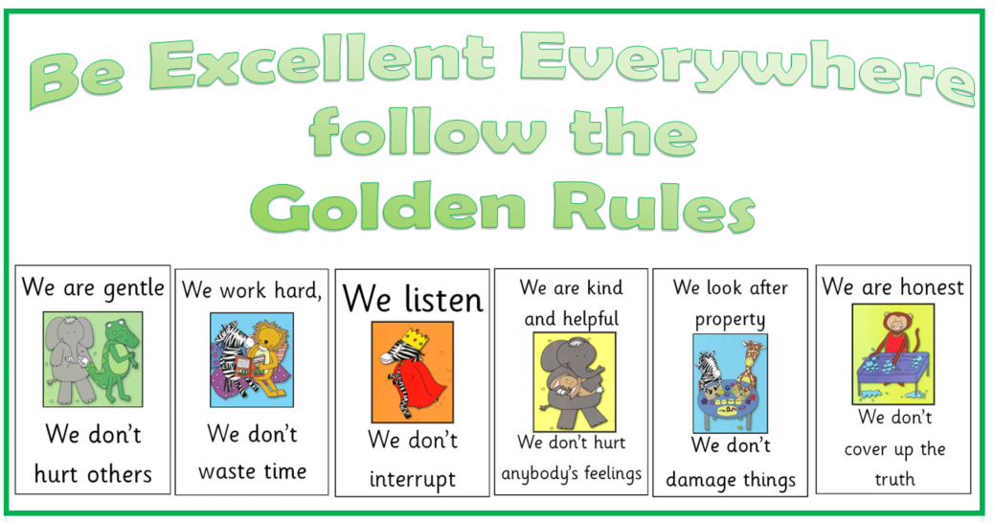
Golden Rules
At Langstone, we follow the six Golden Rules to make our school a safe and happy environment.

Slide 3
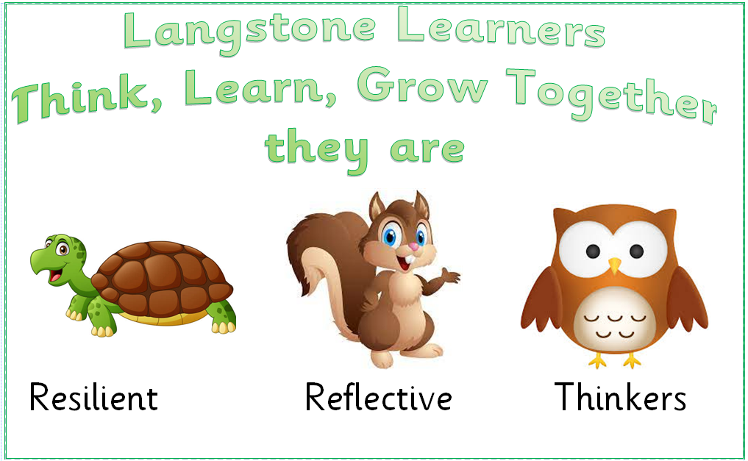
Langstone Learners
At Langstone, we aim to develop learners who are reflective, resilient thinkers and challenge themselves in all areas of learning both in and out of school. We believe that children need to develop a skills set that enables them to achieve this and become confident learners. When we see the children displaying one of these learning powers we will award them a merit.

Slide 4
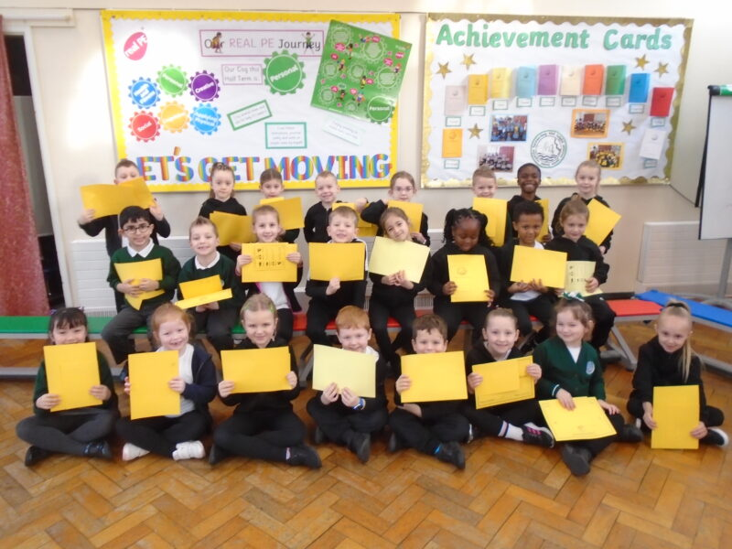
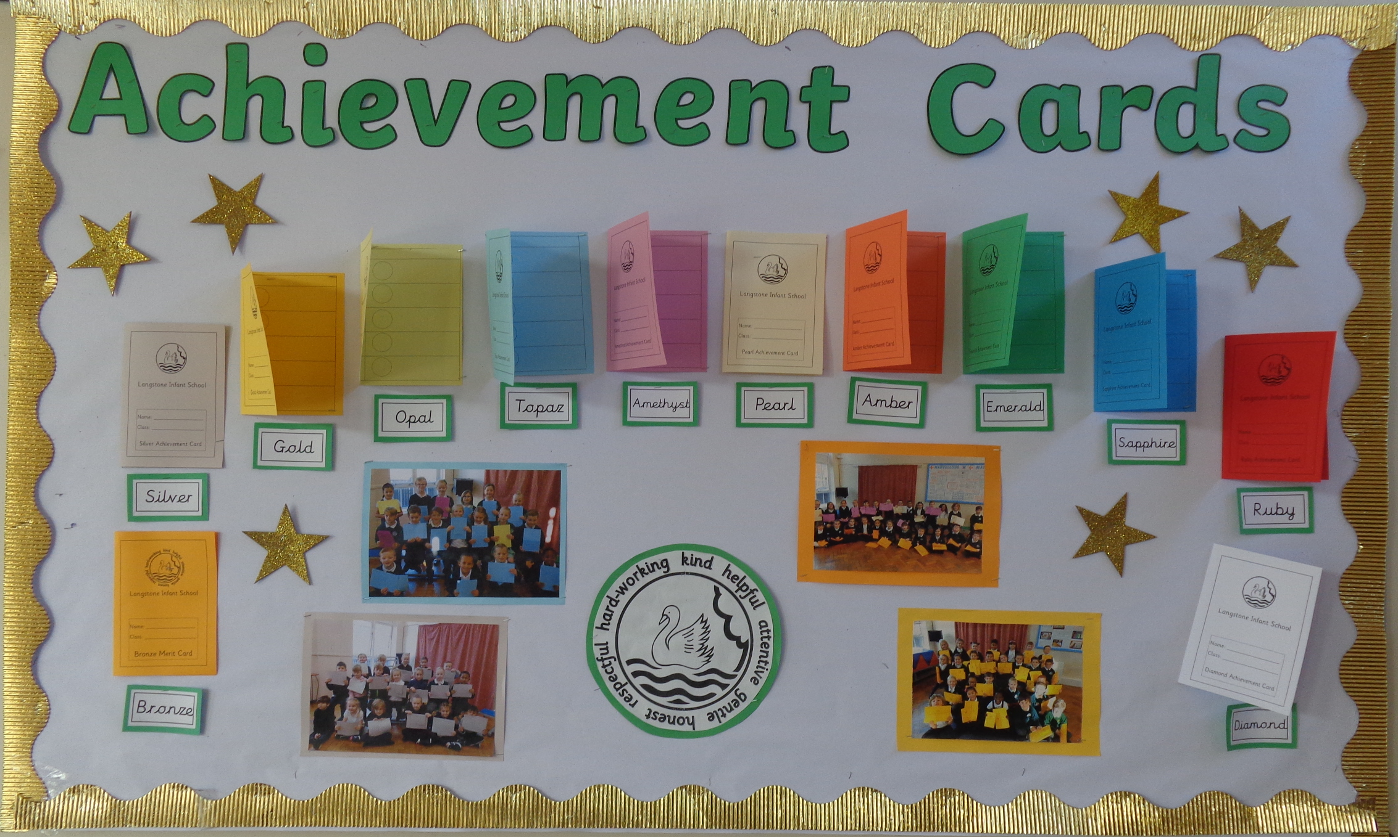
Merits
What is a Merit Award?
Children are given merits in school for many reasons. These can include following the Golden Rules, completing a piece of amazing work by being a resilient, reflective thinker or for being a kind friend.
Every time a child earns a merit, the reason is recorded on their merit card. When the ten slots are full, they attend an Achievement Assembly to celebrate their success.
Parents are invited along to these special assemblies and each child is called to the front to receive their certificate and one of the merits is read from the card. The children are given a certificate and move onto the next colour of merit card.
A special Achievement Assembly is held regularly for pupils who
have completed their merit cards and parents and carers are
invited to join us for this.

Slide 5
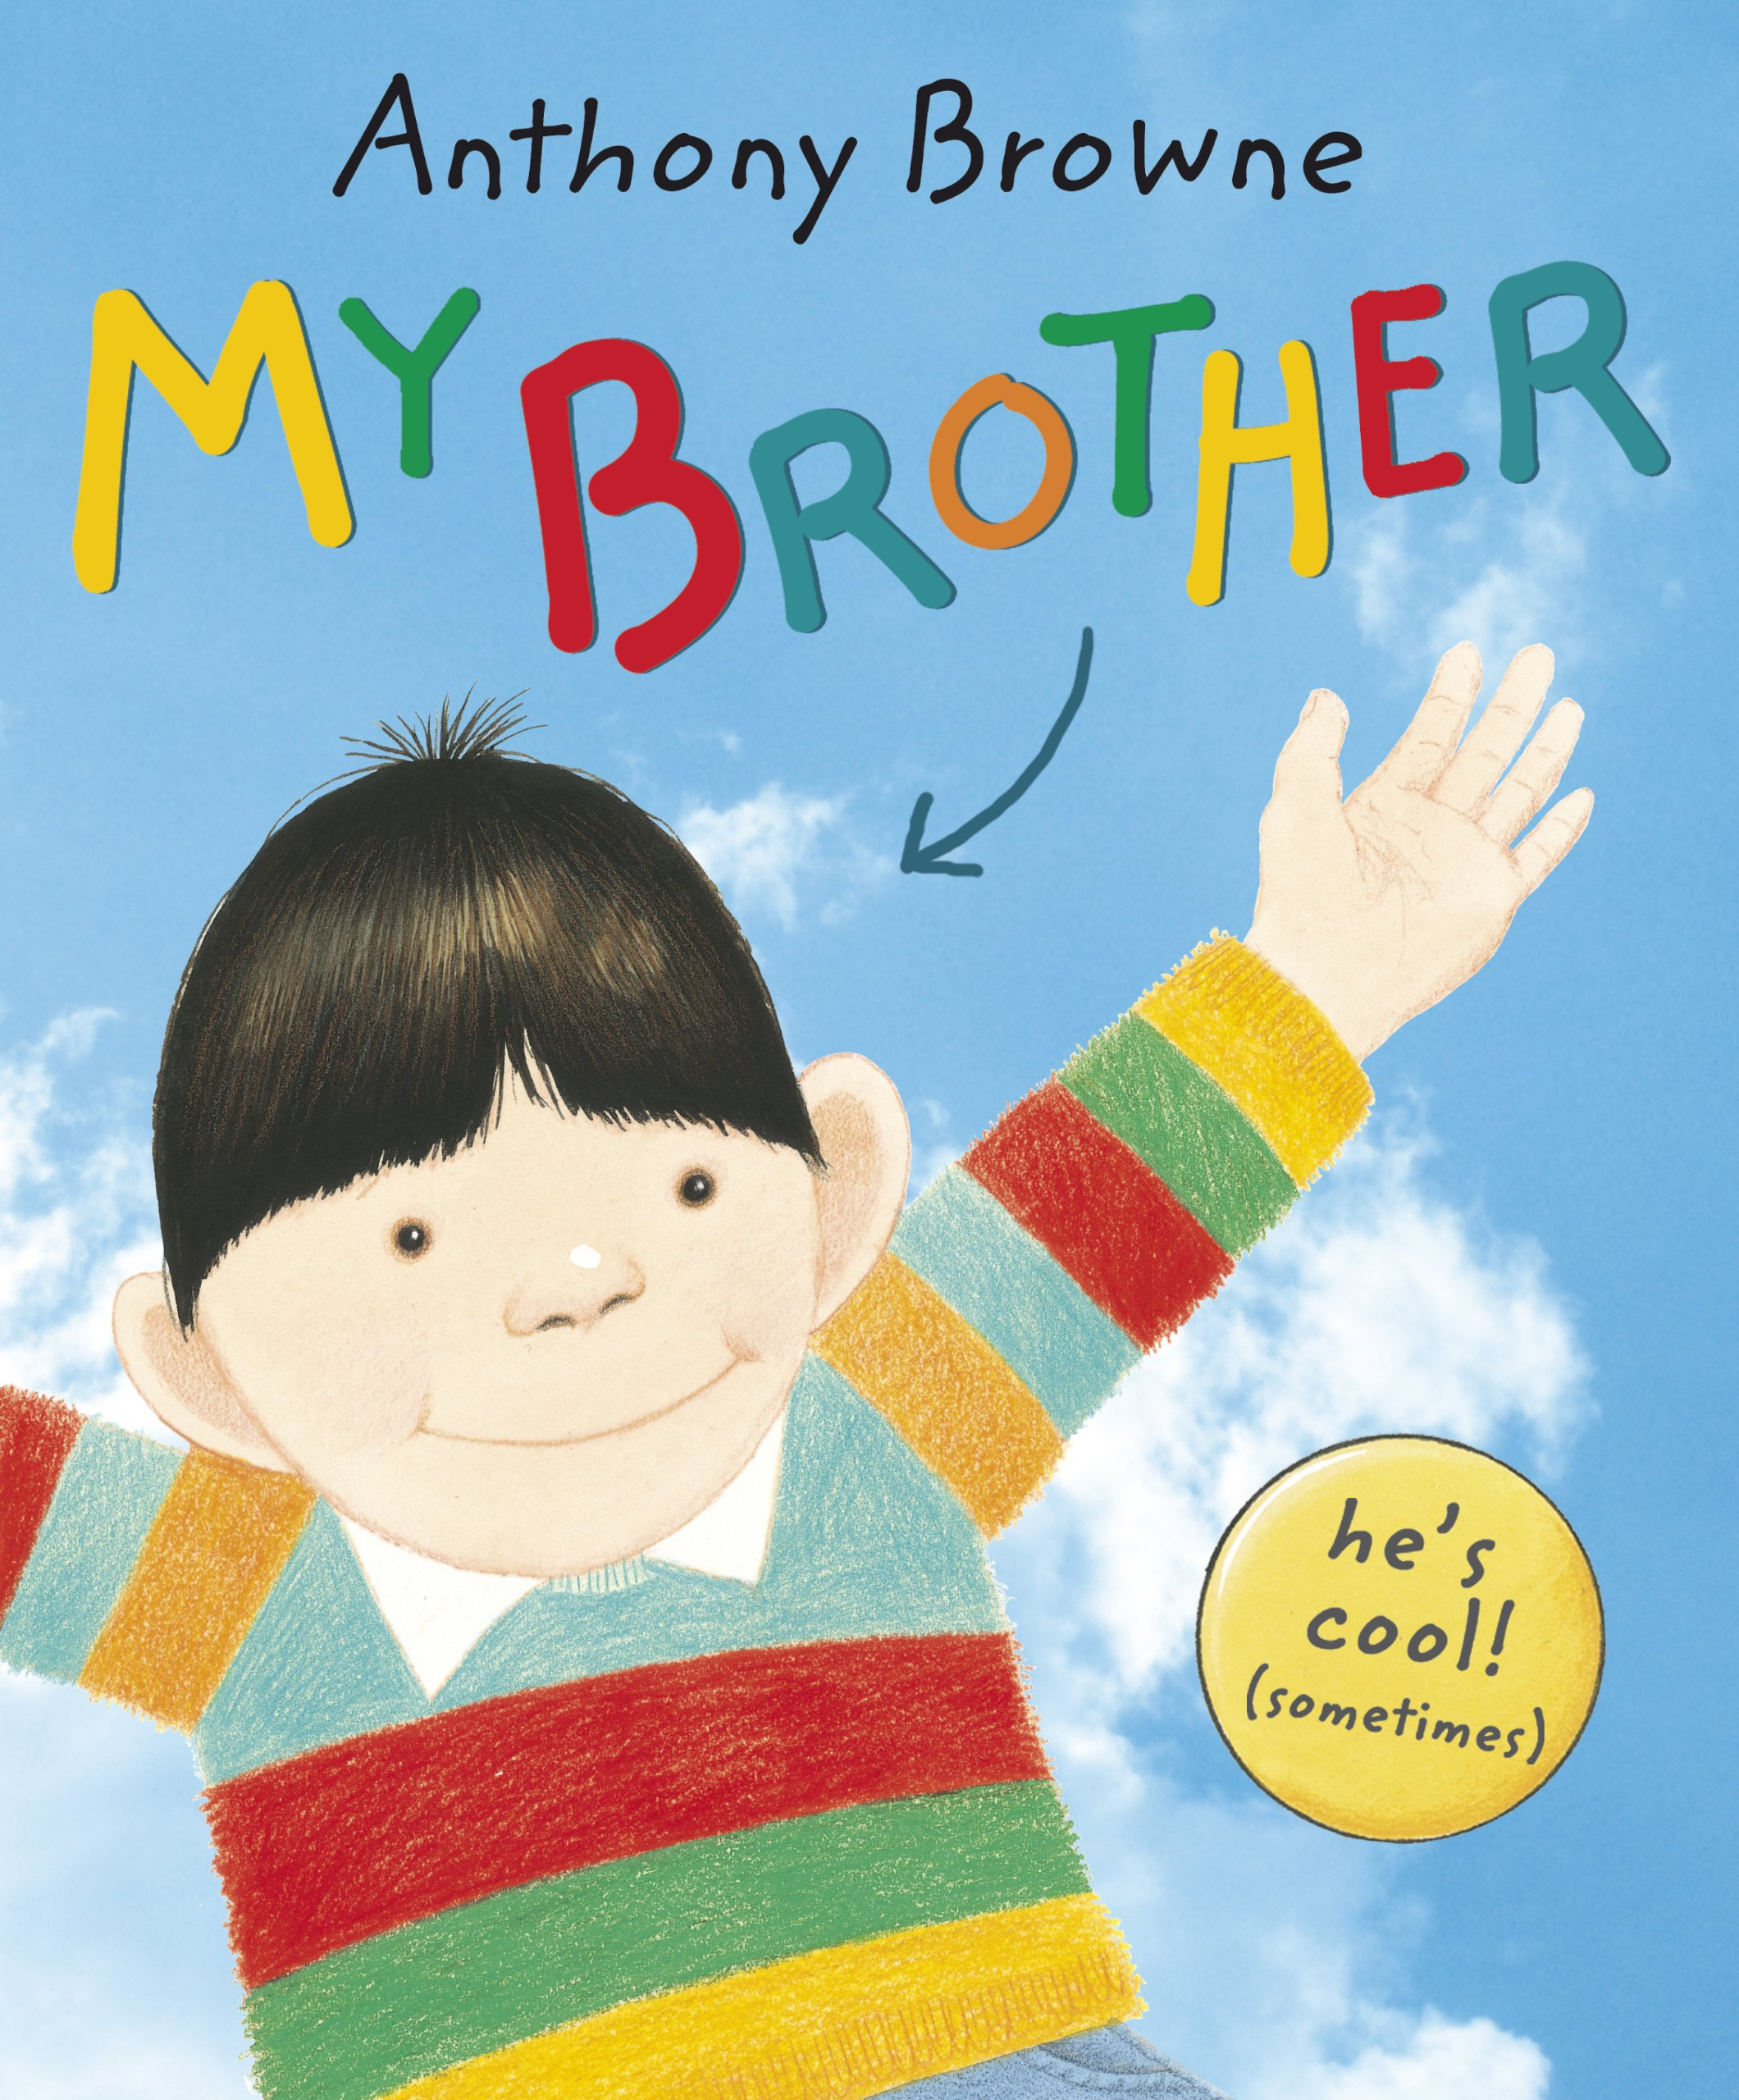








English and Maths
When | English | Maths
Autumn | My Brother – Talk for write and retell We’re All Wonders – Non-fiction booklet Tell me a dragon – dragon descriptions, instructions and recount writing | Place Value 0-100 Addition and Subtraction
Spring | Traditional Tales – Alternative Narrative, Instructions Dear Green Peace - Letter to persuade, Narrative Snail and The Whale – part 2 of the story | Shape Multiplication Money Division
Summer | Whales – Non-Chronological Report, Please Mrs Butler – performance poetry | Fractions Measurement Time Statistics Position and Direction

Slide 6
Our Topics
Topic | Subject
The World Around Me | Geography – Human and Physical features
Fire! Fire! | History – The Great Fire of London
Historical Heroes | History – Significant people in history focus on Florence Nightingale
Seaside Explorers | Geography – Local area study

Slide 7
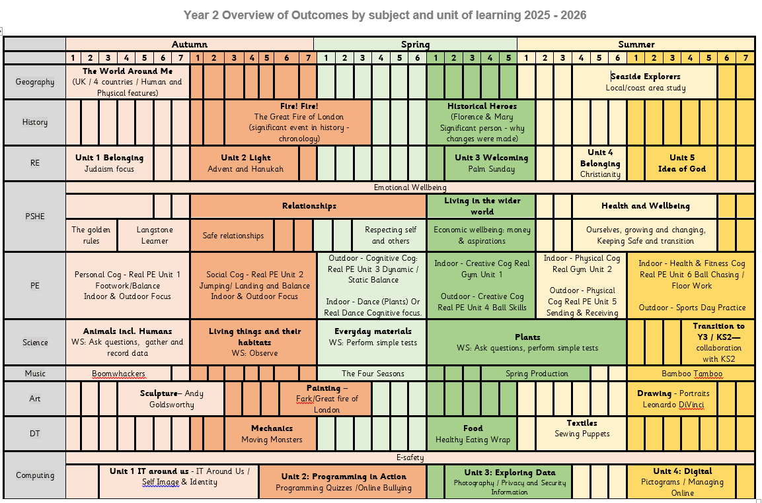
Year 2 Subject Overviews

Slide 8
Enrichment – trips, workshops and special days
Term | Activity
Autumn | Author Week
Autumn | Show Racism the Red Card day
Autumn | Firefighter Visit/Fire safety Workshop
Autumn | Harvest Festival
Autumn | Kindness Week
Autumn | Great Fire of London Drama Workshop
Spring | Safer Internet Day
Spring | Taste and Sensory Session – Caterlink Workshop
Spring | Fort Nelson – (History - Florence Nightingale)
Spring | Children Mental Wellbeing Week
Spring | Future Self Day (PSHE)
Spring | Teddy Bear Care Day (History/PSHE)
Spring | World Book Day
Spring | STEM week
Summer | Arts Week
Summer | Mental Health Week
Summer | Coastline (Geography – coasts)
Summer | Diversity Day
Summer | Stacey Centre (Science – Plants) TBC

Slide 9


PE
PE Days
Year 2’s PE Days are: Monday and Tuesday
Please arrive at school in your PE kit and remain in this for the day.
PE uniform
Black shorts or leggings
White t-shirt
Black tracksuit bottoms
Black jumper and trainers.
Please remember:
- No jewellery can be worn during PE sessions, this includes any earrings, even studs. If your child cannot remove their own stud earrings for these sessions, they will need to have them removed at home or covered over with medical tape on PE days.
-Watches must not be worn so we ask you not to send your child in with a watch on their PE days.

Slide 10

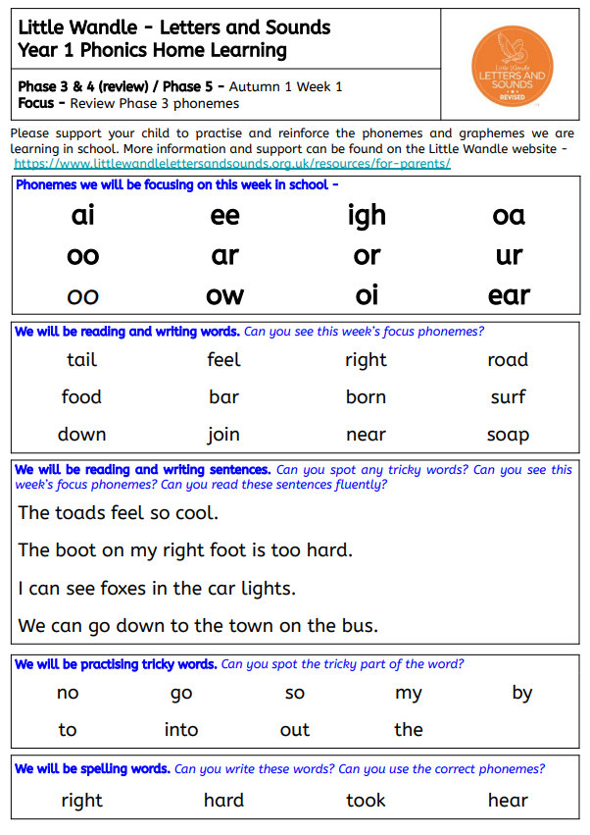
Home learning
Activity
Daily reading | We will send home three books in your child’s book bag. A book that is closely matched to their phonic ability, a ‘challenge’ book that they may need some additional support with and a ‘love of reading’ book for you to share with your child. Please make a note of any reading your child does or any books that you share together so we can see which texts your child is accessing and enjoying.
Phonics practice and Spellings | While your child is learning the Little Wandle phonic program during Year R, 1 and some of Year 2, we may send home additional home practice sheets. The aim of these sheets is for your child to practice reading the phonemes that they have been learning in school that week. In Year 2 the children will move onto spelling practice and will bring home a set of spellings to practice. More Information to follow.
Topic Home learning | Your child may bring home an additional home learning activity to launch their new learning topic. This will usually be a creative activity to help your child to build some background knowledge and discuss vocabulary around the upcoming topic.

