Slide 1

Welcome to Year 1
Langstone Academy is a community of learners who strive and aspire to ‘be excellent everywhere’. As learners, we seek to challenge and question the world around us to develop the skills to be lifelong learners.
1WB: Mrs Watson & Mrs Blakely (Year Leader)
1Br: Miss Brand
1Be: Miss Beckwith

Slide 2
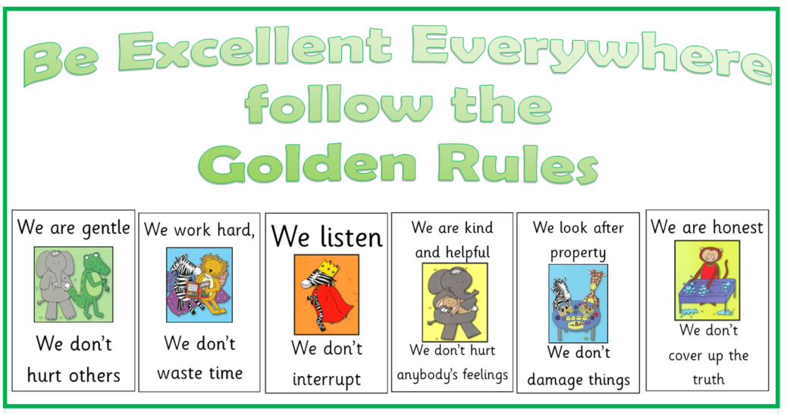
Golden Rules
At Langstone, we follow the six Golden Rules to make our school a safe and happy environment.

Slide 3
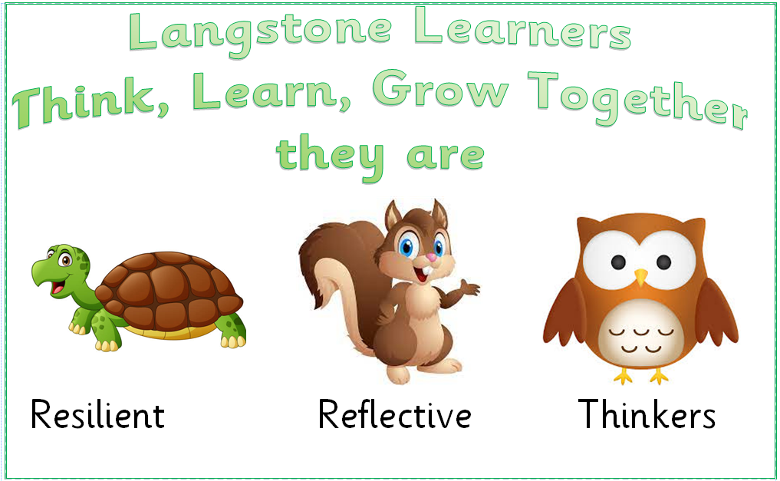
Langstone Learners
At Langstone, we aim to develop learners who are reflective, resilient thinkers and challenge themselves in all areas of learning both in and out of school. We believe that children need to develop a skills set that enables them to achieve this and become confident learners. When we see the children displaying one of these learning powers we will award them a merit.

Slide 4
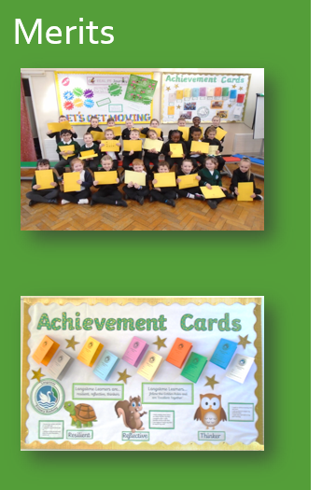
Merits
What is a Merit Award?
Children are given merits in school for many reasons. These can include following the Golden Rules, completing a piece of amazing work by being a resilient, reflective thinker or for being a kind friend.
Every time a child earns a merit, the reason is recorded on their merit card. When the ten slots are full, they attend an Achievement Assembly to celebrate their success.
Parents are invited along to these special assemblies and each child is called to the front to receive their certificate and one of the merits is read from the card. The children are given a certificate and move onto the next colour of merit card.
A special Achievement Assembly is held for pupils who have completed their merit cards and parents and carers are invited to join us for this.

Slide 5







English and Maths
Year 1
When | English | Maths
Autumn | You Choose – Talk for writing Autumn Senses poetry Elmer – Talk for writing and toolkits Traction Man – simple story writing, Toys - instructions | Place value 0-10 Addition and subtraction 0-10 Shape
Spring | Mrs Armitage Queen of the road & Mrs Armitage On Wheels – Character descriptions, language and story writing Man on the Moon – Letter writing | Composition and place value to 100 Addition and subtraction within 100 Measure, length and capacity
Summer | The Little Mole - retell Traditional Tales – character and setting descriptions, story opening and instructions | Composition 11-19 Counting and unitising coins Time Position and direction

Slide 6
Our Topics
Topic | Subject
Where I live | Geography – Exploring the local area; classroom, school, Baffins
Toys | History – comparison of toys past and present
Famous Faces & Events | History – Neil Armstrong & Tim Peake – The Moon Landing
My Corner of the World – Exploring the wider area | Geography – Exploring the wider area – Portsmouth, England, UK

Slide 7
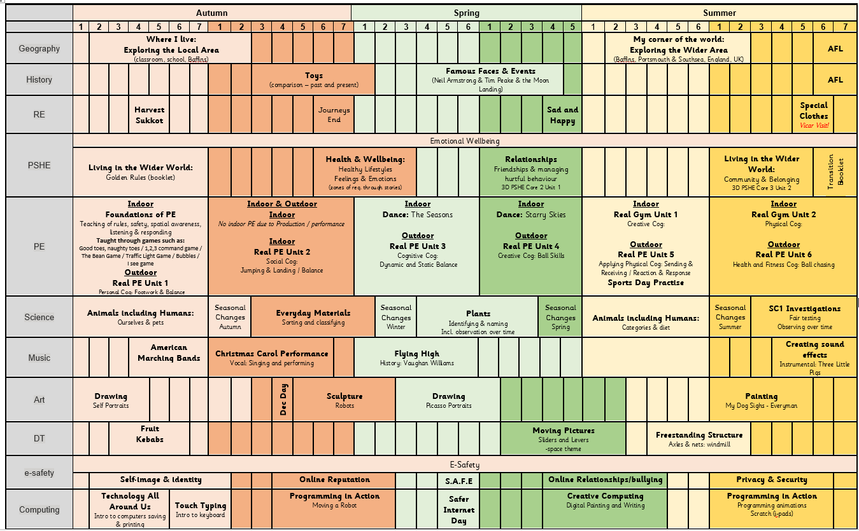
Year 1 Subject Overviews

Slide 8
Enrichment – trips, workshops and special days
Term | Activity
Autumn | Author Week
Autumn | Harvest Festival
Autumn | Show Racism the Red Card
Autumn | Kindness Week
Autumn | Toys and Games Workshop (History – toys)
Autumn | Fruit Pizza Making- Caterlink workshop
Autumn | Year 1 Carol Performance in the church
Autumn | Baffins Walk
Spring | Drama Workshop
Spring | Safer Internet Day
Spring | Drama 4 All – Drama Workshop
Spring | Children Mental Wellbeing Week
Spring | Space Day (History)
Spring | World Book Day
Spring | STEM week
Summer | Arts Week
Summer | Mental Health Week
Summer | My Dog Sighs Video Tutorial (Art – painting)

Slide 9


PE
PE Days
Year 1 PE is on Wednesday & Friday.
Please arrive at school in your PE kit and remain in this for the day.
PE uniform
Black shorts or leggings
White t-shirt
Black tracksuit bottoms
Black jumper and trainers.
Please remember:
- No jewellery can be worn during PE sessions, this includes any earrings, even studs. If your child cannot remove their own stud earrings for these sessions, they will need to have them removed at home or covered over with medical tape on PE days.
-Watches must not be worn so we ask you not to send your child in with a watch on their PE days.

Slide 10

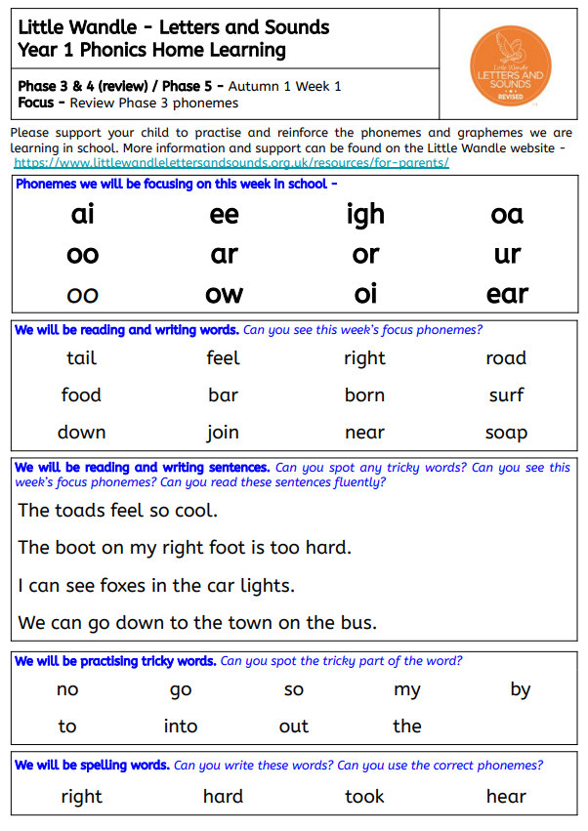
Home learning
Activity
Daily reading | We will send home three books in your child’s book bag. A book that is closely matched to their phonic ability, a ‘challenge’ book that they may need some additional support with and a ‘love of reading’ book for you to share with your child. Please make a note of any reading your child does or any books that you share together so we can see which texts your child is accessing and enjoying.
Phonics practice and Spellings | While your child is learning the Little Wandle phonic program during Year R, 1 and some of Year 2, we may send home additional home practice sheets. The aim of these sheets is for your child to practice reading the phonemes that they have been learning in school that week. In Year 2 the children will move onto spelling practice and will bring home a set of spellings to practice.
Topic Home learning | Your child may bring home an additional home learning activity to support their new learning topic. This will usually be a creative activity to help your child to build some background knowledge and discuss vocabulary around the upcoming topic.

