Slide 1

Welcome to Year 4
Langstone Academy is a community of learners who strive and aspire to ‘be excellent everywhere’. As learners, we seek to challenge and question the world around us to develop the skills to be lifelong learners.
4P: Mr Phelan (Year Leader)
4L: Mr Lawrence
4B: Miss Brazier

Slide 2





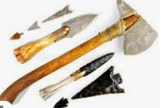


English and Maths
When | English | Maths
Autumn | The Promise - Setting description Aquarium – Recount Stone Age – Non-Chronological report | Addition and subtraction Numbers to 10,000 Perimeter 3, 6, 9x tables
Spring | Poetry – cinquains and haiku Traditional Tales –’What happened next?’ Harry Potter – Letter – Character Description | 7x tables Multiplication and division Division with remainders
Summer | Water Cycle – Explanation The Giant’s Necklace – Narrative | Fractions Shape Time Co-ordinates

Slide 3
Our Topics
Topic | Subject
Blue Abyss | Geography – Oceans
Rockin’ the Ages | History – Stone Age
From Village to City | Geography - local study
Veni Vidi Vici | History – Romans

Slide 4
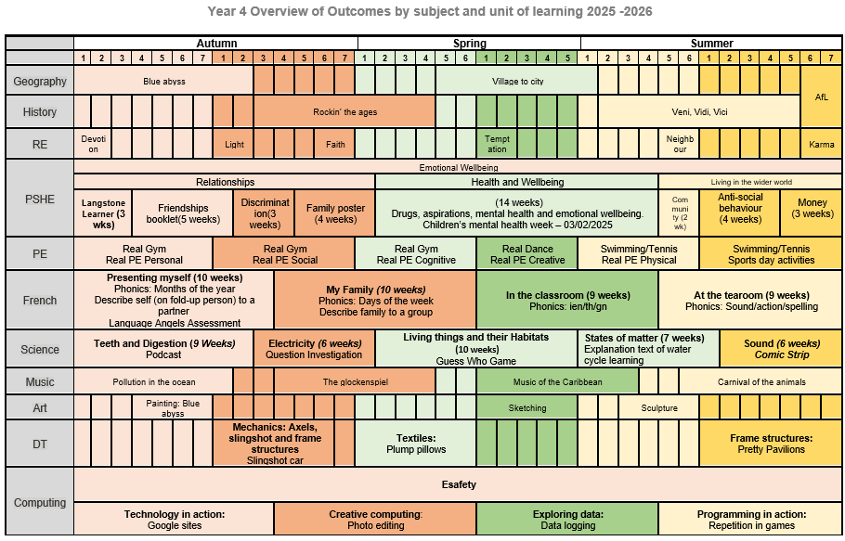
Year 4 Subject Overviews

Slide 5
Enrichment – trips, workshops and special days
Term | Activity
Autumn | Harvest Festival
Autumn | Brighton Aquarium trip (Geography - Blue Abyss)
Autumn | Show Racism the Red Card Day
Autumn | STEM workshop (Science – Electricity)
Autumn | Anti-bullying week
Autumn | Stone Age Day (History – The Stone Ages)
Spring | Safer Internet Day
Spring | St Cuthbert’s Vicar visit (RE – Christianity)
Spring | Children Mental Wellbeing Week
Spring | Fernhurst trip – Village to city
Spring | World Book Day
Summer | Residential trip – Sustainability centre
Summer | Times Table Rock Star Day
Summer | Mental Health Week
Summer | Arts Week
Summer | STEM workshop (Science – Sound)
Summer | Fishbourne Roman Palace trip
Summer | Roman Day (History - Romans)
Summer | Swimming
Summer | School’s Diversity Day

Slide 6


PE
PE is on Monday and Thursday
Please arrive at school in your PE kit and remain in this for the day.
Monday is Outdoor PE.
Thursday is Indoor PE.
PE uniform for Real Gym (Thursday):
Black shorts, leggings or ‘skins’
White t-shirt
No shoes or socks
NO tracksuit bottoms or sweatshirt to be worn during the lesson although they can be worn to school.
PE uniform for outdoor PE (Monday):
Black shorts, leggings or ‘skins’
White t-shirt
Black tracksuit bottoms
Black jumper
Please remember:
- No jewellery can be worn during PE sessions, this includes any earrings, even studs. If your child cannot remove their own stud earrings for these sessions, please do not send them into school wearing them on their Real Gym days.
-Watches must not be worn so we ask you not to send your child in with a watch on their PE days.

Slide 7

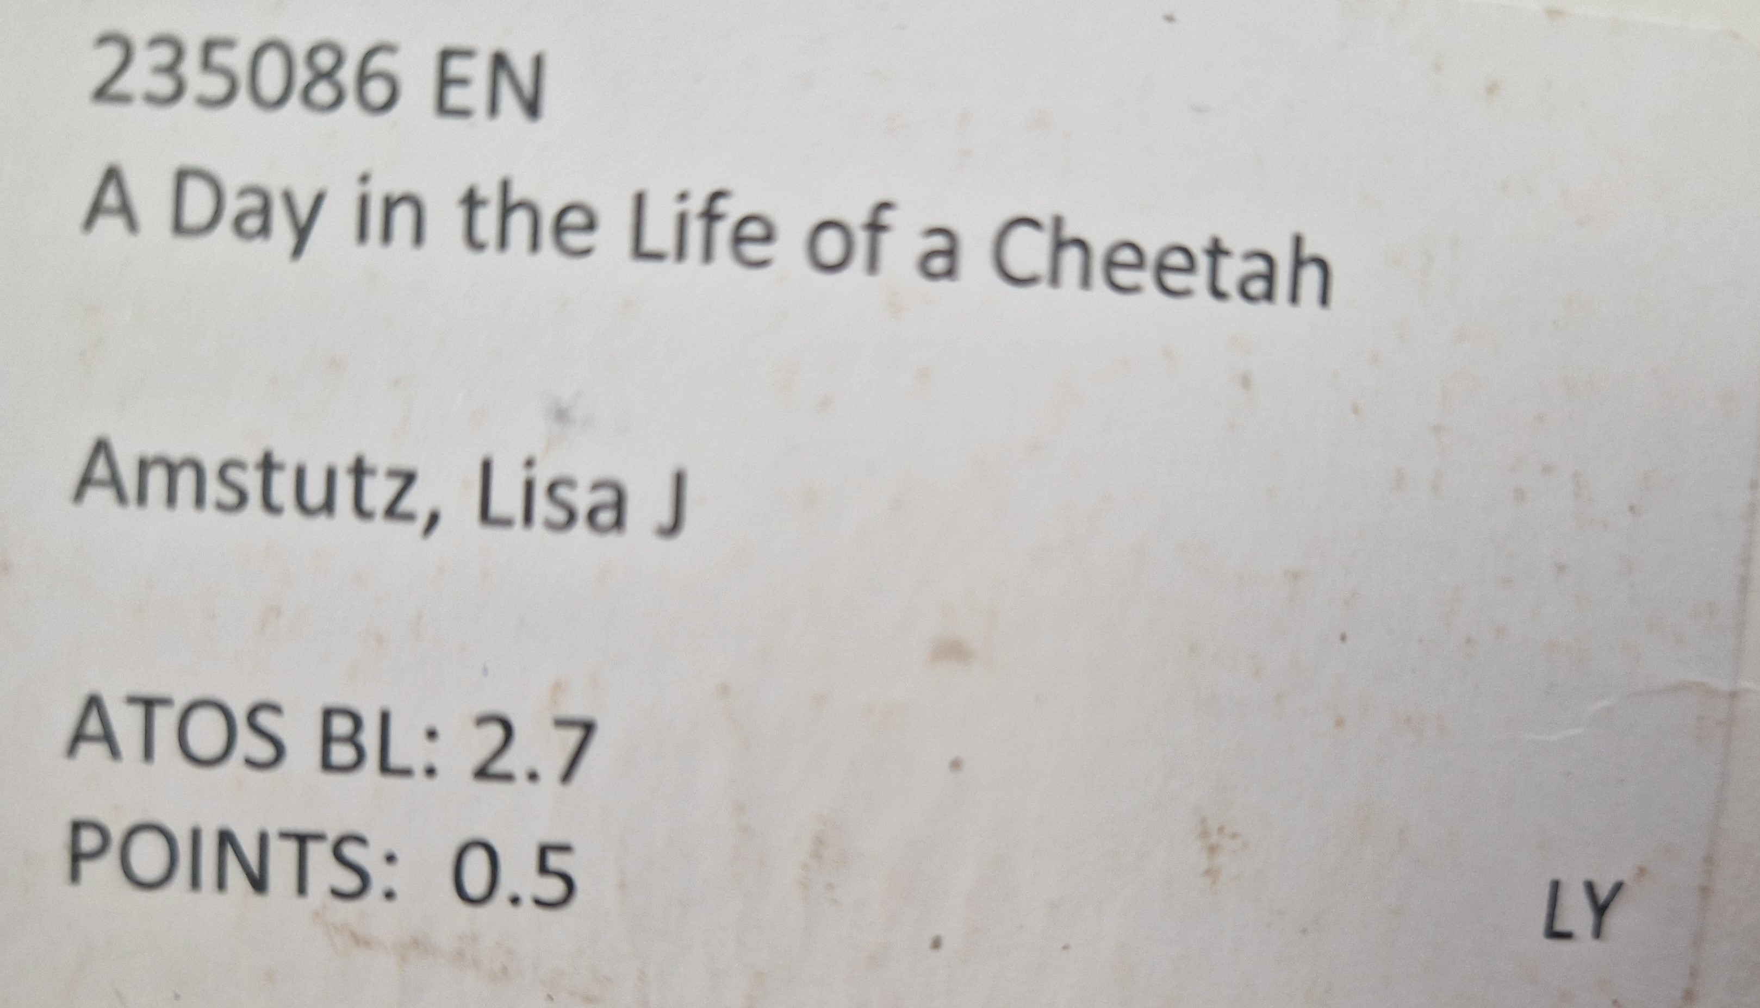
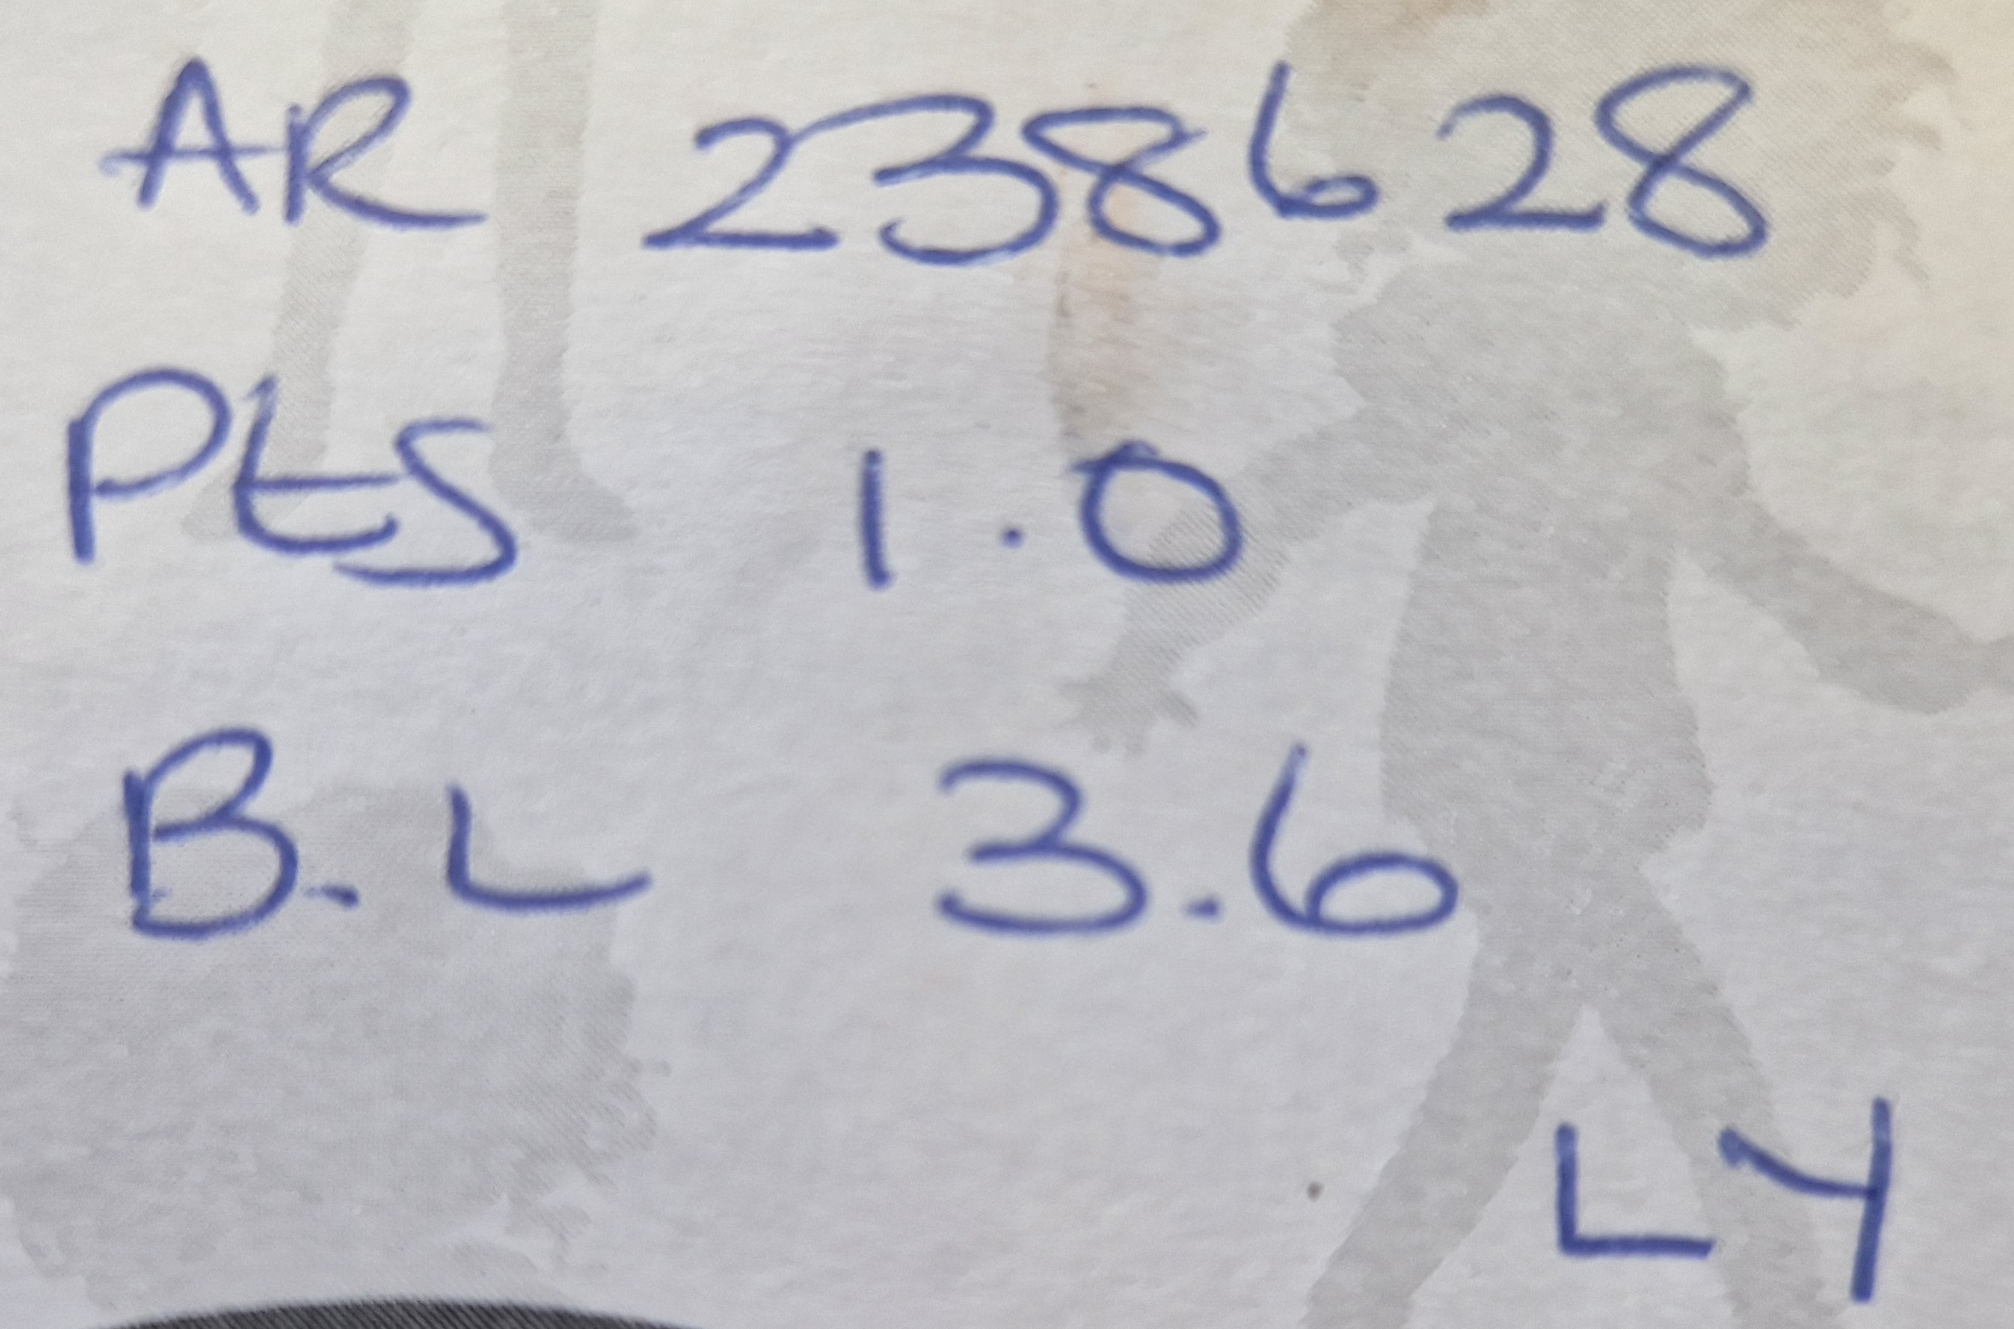


Home learning
Activity
Daily reading | Regular reading of a variety of genres is an integral part of the curriculum and develops a range of skills that children can utilise on a daily basis. We expect children to read regularly and aim for at least 5 times a week. When your child finished a book, they can complete a quiz using Accelerated Reader (https://ukhosted105.renlearn.co.uk/6708094/). The quiz number can be found inside the front cover of the book and may look like this: Your child can also access a variety of eBooks which they can read independently or be read to them at: https://www.myon.co.uk/login/ Myon uses the same username and password as Accelerated Reader.
Daily times tables practice | This could be chanting, rapid recall or quick fire questions with a family member, use of Times Tables Rockstar (https://ttrockstars.com/) or playing different times tables games. By the end of Year 4, Government expectations are that children will have rapid and fluent recall of all of their times tables up to 12 x 12.
Spellings | We expect children to learn the Year 4 National Curriculum spellings and each week, a new word will be sent out to learn. In addition, they will be tested on them at the end of each half term.

Slide 8
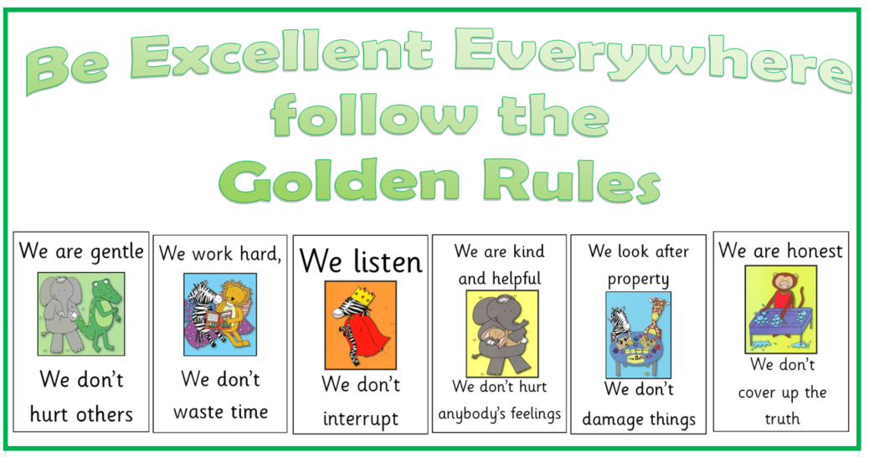
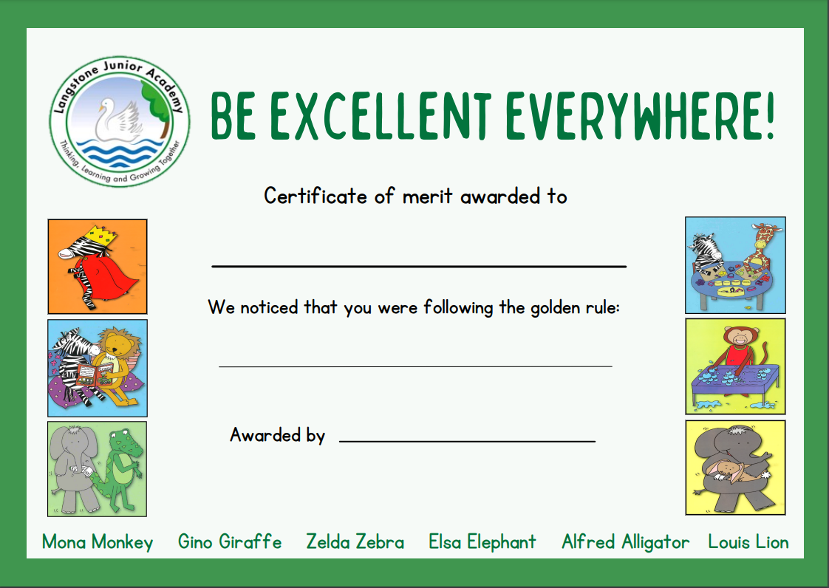
Golden Rules
At Langstone, we follow the 6 Golden Rules to make our school a safe and happy environment.
In celebration assembly, we celebrate children who have demonstrated these skills.

Slide 9




Langstone Learners
What is the Langstone Learner Award?
At Langstone Primary Academy, we are proud to have created and continue to promote our ‘Langstone Learner Award’. We aim to develop learners who are reflective, resilient thinkers and challenge themselves in all areas of learning both in and out of school.
The Langstone Learner award is a three-tiered system which empowers children to recognise and develop a set of progressively challenging skills as they develop as independent learners.
Tier
TIER 1 | ALL NEW CHILDREN TO THE SCHOOL (8 SKILLS PER AREA = 24 SKILLS) | The class teacher will observe these learning behaviours over a period of time and when evidenced consistently, will discuss this with the child and a sticker added to show achievement.
TIER 2 | TYPICALLY YEAR 4 BUT PROGRESSION WHEN APPROPRIATE FROM TIER 1 (5 SKILLS PER AREA = 15 SKILLS) | The children begin to record evidence of them meeting a skill, supported by an adult to begin with. Each skill has room to record evidence underneath. There are also additional pages in the booklet for this if needed.
TIER 3 | TYPICALLY YEAR 5 BUT PROGRESSION WHEN APPROPRIATE FROM TIER 2 (4 SKILLS PER AREA = 12 SKILLS) | The children independently record evidence of them meeting a skill. Each skill has room to record evidence underneath. There are also additional pages in the booklet for this if needed.
MASTER LEARNER | AWARDED UPON COMPLETION OF ALL THE TIERS IN ALL 3 AREAS – THINKING, RESILIENCE AND REFLECTIVENESS.
Once a tier has been achieved, you will be invited to a special celebration assembly held twice a half term. Invitations will be sent via Parentmail once the tier has been validated by the Year Leader. In this assembly, your child will be awarded with a band which corresponds with the Tier they have completed. If they have achieved all three tiers, they are now a master learner and will also be awarded with a grey ‘Master Learner’ t-shirt which can be worn in place of their normal white uniform top.

Slide 10
Class Assemblies
Each year we would like to welcome families in to watch their child in a class assembly.
This is a chance for your child to share some of their learning and practice the key skills of performing.
Assemblies take place at 8:50. If you wish to attend, please enter through our school office 10 minutes before the start time to allow time to sign in.
Class | Date
4P | Tuesday 3rd March
4L | Tuesday 17th March
4B | Tuesday 24th March

Slide 11
Useful websites to use at home
Accelerated Reader | https://ukhosted105.renlearn.co.uk/6708094/
Times table Rockstar | https://ttrockstars.com/
Spelling Shed | https://www.spellingshed.com/en-gb/
Myon (reading) | https://www.myon.co.uk/index.html

