Slide 1

Welcome to Year 5
Langstone Academy is a community of learners who strive and aspire to ‘be excellent everywhere’. As learners, we seek to challenge and question the world around us to develop the skills to be lifelong learners.
5C: Miss Chappell (Year leader)
5S: Mr Shaw
5D: Miss Dann

Slide 2








English and Maths
When | English | Maths
Autumn | Traditional Tales – Different perspectives Climate change – Persuasive Writing Street Child – Narrative | Decimal fractions Money Place Value to 1,000,000 Negative numbers Short multiplication and division
Spring | Street Child – Diary Space – Setting Description Cosmic – Narrative | Area and scaling Calculating with decimals Factors, multiples and primes
Summer | Poetry – Learning poetry by heart Scientists – Biographies Just So stories – African Myths | Fractions Converting units Angles

Slide 3
Our Topics
Topic | Subject
Our Climate, Our Future | Geography – Climate change
Top Hats and Chimney Sweeps | History – Victorians
Sailing the Waves | History & Geography – The Titanic
V for Victory | History – World War Two

Slide 4
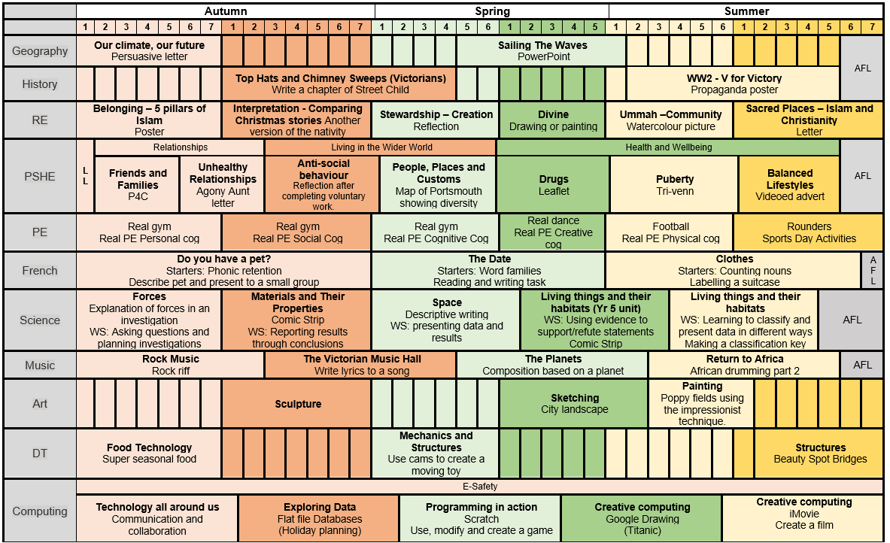
Year 5 Subject Overviews

Slide 5
Enrichment – trips, workshops and special days
Autumn | Activity
Autumn | Harvest Festival
Autumn | Eco VR Workshop (Topic – Our Climate, Our Future)
Autumn | STEM Workshop (Science – Pulleys and Levers)
Autumn | Show Racism the Red Card Day
Autumn | Victorian Day (History – The Victorians)
Autumn | Anti-bullying week
Spring | Winchester Science Museum (Science—Space)
Spring | Safer Internet Day
Spring | Children Mental Wellbeing Week
Spring | World Book Day
Spring | City Life Church or St Cuthbert’s Church (PSHE – community)
Spring | SeaCity Museum (History—The Titanic)
Spring | STEM week
Summer | Times Table Rock Star Day
Summer | Mental Health Week
Summer | Arts Week
Summer | Caterlink Biscuit Making Workshop
Summer | D Day Museum (History—WWII)
Summer | Bikeability (Bike safety)
Summer | School’s Diversity Day

Slide 6
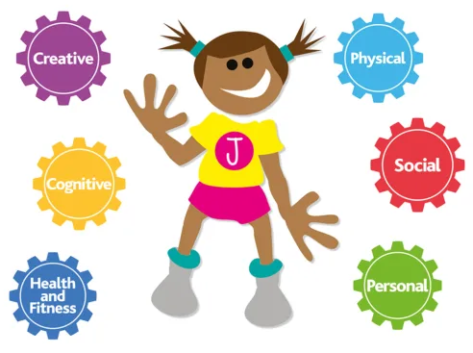

PE
PE is on Wednesday and Thursday.
Please arrive at school in your PE kit and remain in this for the day.
Wednesday is Indoor PE day.
Thursday is Outdoor PE day.
PE uniform for Real Gym (Wednesday):
Black shorts, leggings or ‘skins’
White t-shirt
No shoes or socks
NO tracksuit bottoms or sweatshirt to be worn during the lesson although they can be worn to school.
PE uniform for outdoor PE (Thursday):
Black shorts, leggings or ‘skins’
White t-shirt
Black tracksuit bottoms
Black jumper
Please remember:
- No jewellery can be worn during PE sessions, this includes any earrings, even studs. If your child cannot remove their own stud earrings for these sessions, please do not send them into school wearing them on their PE days.
-Watches must not be worn so we ask you not to send your child in with a watch on their PE days.

Slide 7

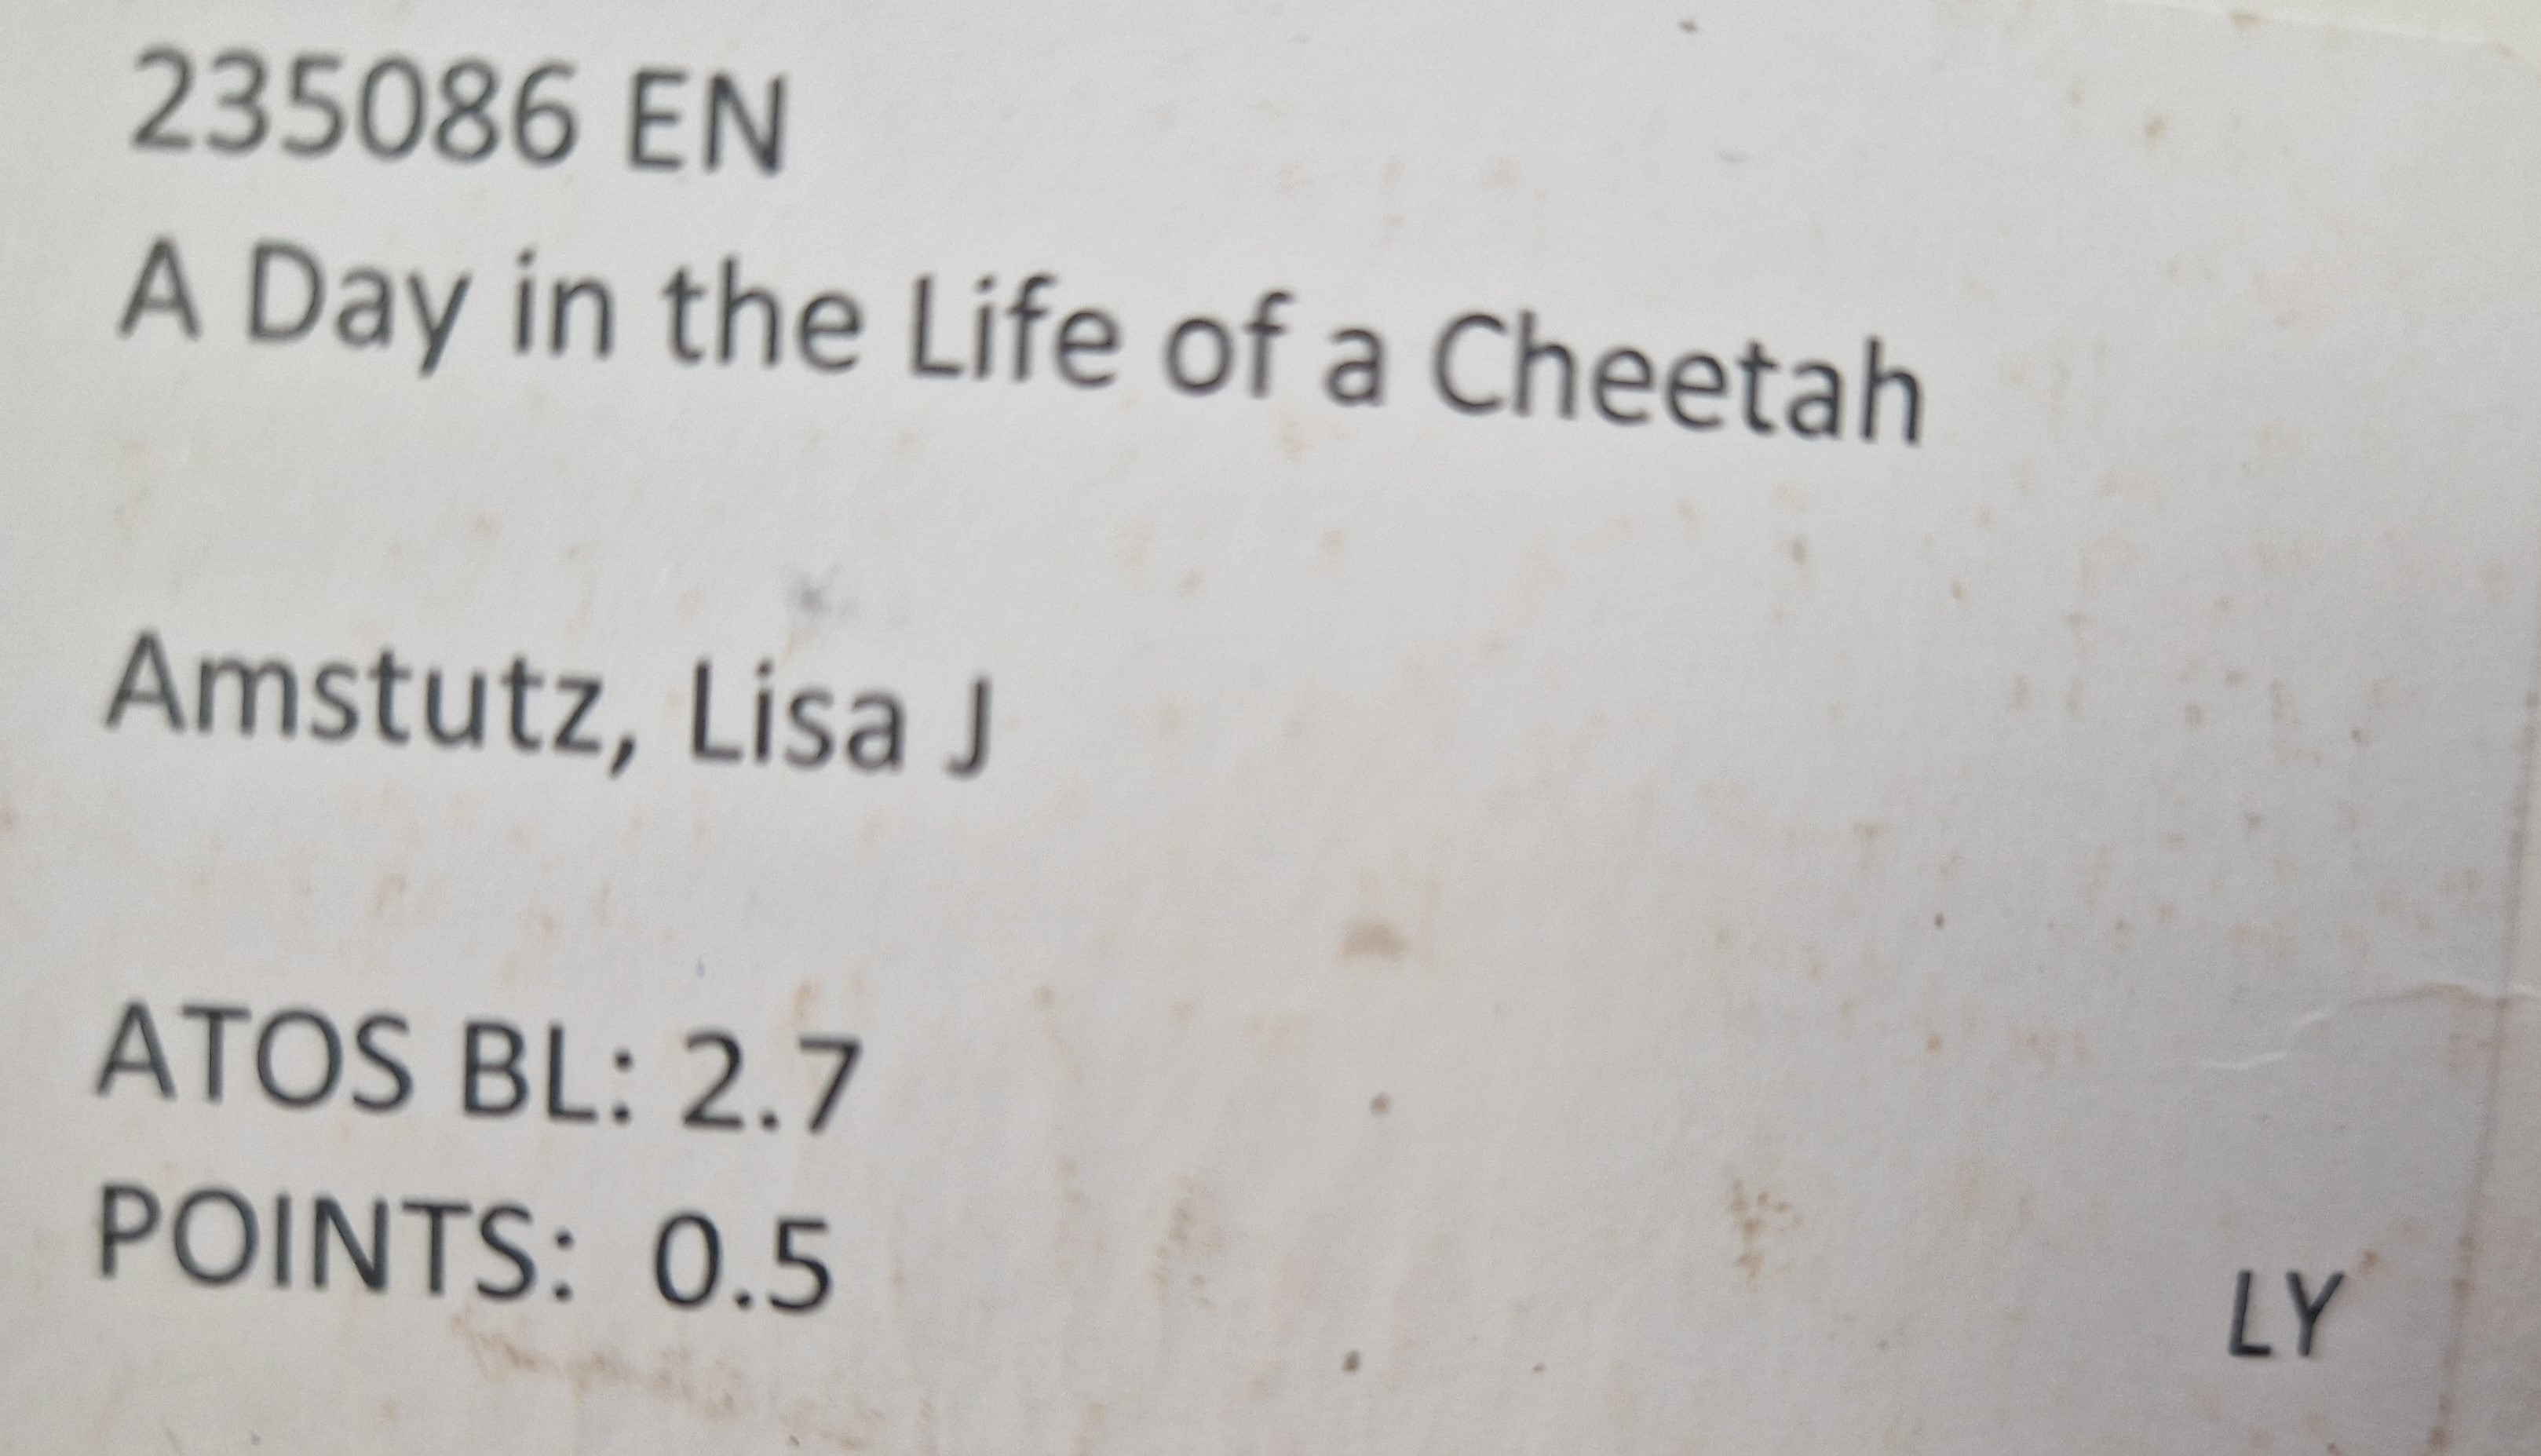
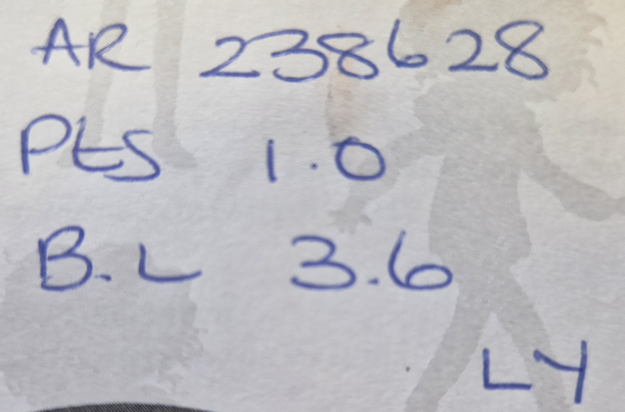


Home learning
Activity
Daily reading | Regular reading of a variety of genres is an integral part of the curriculum and develops a range of skills that children can utilise on a daily basis. We expect children to read regularly and aim for at least 5 times a week. When your child finished a book, they can complete a quiz using Accelerated Reader (https://ukhosted105.renlearn.co.uk/6708094/). The quiz number can be found inside the front cover of the book and may look like this: Your child can also access a variety of eBooks which they can read independently or be read to them at: https://www.myon.co.uk/login/ Myon uses the same username and password as Accelerated Reader.
Daily times tables practice | Children are expected to complete 30 minutes of Times Table Rockstar Garage sessions each week to consolidate their knowledge of all the times tables up to 12 x 12 (https://ttrockstars.com/). By having a good knowledge of times tables, children will be able to apply it in a range of mathematical contexts.
Spellings | We expect children to learn the Year 5 National Curriculum spellings and each week, 2 new words will be sent out to learn. In addition, they will be tested on them at the end of each half term.

Slide 8
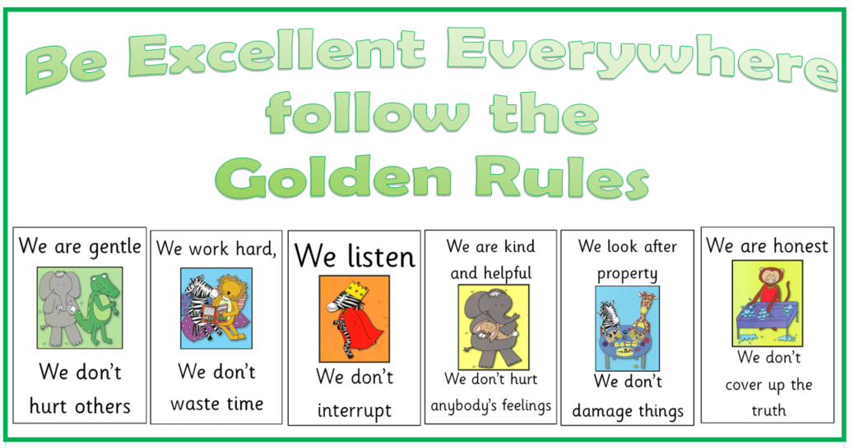
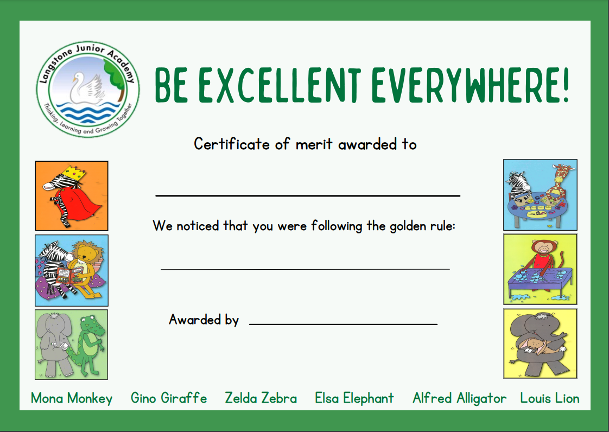
Golden Rules
At Langstone, we follow the 6 Golden Rules to make our school a safe and happy environment.
In celebration assembly, we celebrate children who have demonstrated these skills.

Slide 9




Langstone Learners
What is the Langstone Learner Award?
At Langstone Primary Academy, we are proud to have created and continue to promote our ‘Langstone Learner Award’. We aim to develop learners who are reflective, resilient thinkers and challenge themselves in all areas of learning both in and out of school.
The Langstone Learner award is a three-tiered system which empowers children to recognise and develop a set of progressively challenging skills as they develop as independent learners.
Tier
TIER 1 | ALL NEW CHILDREN TO THE SCHOOL (8 SKILLS PER AREA = 24 SKILLS) | The class teacher will observe these learning behaviours over a period of time and when evidenced consistently, will discuss this with the child and a sticker added to show achievement.
TIER 2 | TYPICALLY YEAR 4 BUT PROGRESSION WHEN APPROPRIATE FROM TIER 1 (5 SKILLS PER AREA = 15 SKILLS) | The children begin to record evidence of them meeting a skill, supported by an adult to begin with. Each skill has room to record evidence underneath. There are also additional pages in the booklet for this if needed.
TIER 3 | TYPICALLY YEAR 5 BUT PROGRESSION WHEN APPROPRIATE FROM TIER 2 (4 SKILLS PER AREA = 12 SKILLS) | The children independently record evidence of them meeting a skill. Each skill has room to record evidence underneath. There are also additional pages in the booklet for this if needed.
MASTER LEARNER | AWARDED UPON COMPLETION OF ALL THE TIERS IN ALL 3 AREAS – THINKING, RESILIENCE AND REFLECTIVENESS.
Once a tier has been achieved, you will be invited to a special celebration assembly held twice a half term. Invitations will be sent via Parentmail once the tier has been validated by the Year Leader. In this assembly, your child will be awarded with a band which corresponds with the Tier they have completed. If they have achieved all three tiers, they are now a master learner and will also be awarded with a grey ‘Master Learner’ t-shirt which can be worn in place of their normal white uniform top.

Slide 10
Class Assemblies
Each year we would like to welcome families in to watch their child in a class assembly.
This is a chance for your child to share some of their learning and practice the key skills of performing.
Assemblies take place at 8:50. If you wish to attend, please enter through our school office 10 minutes before the start time to allow time to sign in.
Class | Date
5C | Tuesday 13th January
5S | Tuesday 20th January
5D | Tuesday 27th January

Slide 11
Useful websites to use at home
Accelerated Reader | https://ukhosted105.renlearn.co.uk/6708094/
Times table Rockstar | https://ttrockstars.com/
Spelling Shed | https://www.spellingshed.com/en-gb/
Myon (reading) | https://www.myon.co.uk/index.html

