Slide 1

Welcome to Year 6
Langstone Academy is a community of learners who strive and aspire to ‘be excellent everywhere’. As learners, we seek to challenge and question the world around us to develop the skills to be lifelong learners.
6JH: Mr Harness (year leader)
6AH: Mr Handley
6J: Miss Jordan

Slide 2
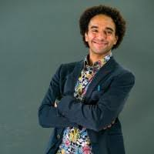





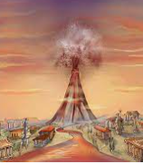

English and Maths
When | English | Maths
Autumn | Eastboune - Poetry The Explorer– Setting Description The Explorer–Retelling Grimm Stories – Own narrative The Grinch - Instructions | Multiples of 1000 Numbers up to 10,000,000 Calculations Multiplication and Division
Spring | Natural disasters – Non-chronological Report Portal story - dialogue Rock, Paper, Scissors – Narrative Pompeii – Narrative Recount Holes – Non-chronological Report | Mean Average Fractions and percentages Shapes Area and perimeter Statistics
Summer | Holes – Instructions Writer’s choice – Persuasion Writer’s choice – Balanced Argument | Ratio and proportion Solving problems with 2 unknowns

Slide 3
Our Topics
Topic | Subject
Travellers of the World | Geography – the natural world and explorers
Living on the Edge | Geography – Natural Disasters History - Pompeii
This is Sparta | History – Ancient Greeks

Slide 4
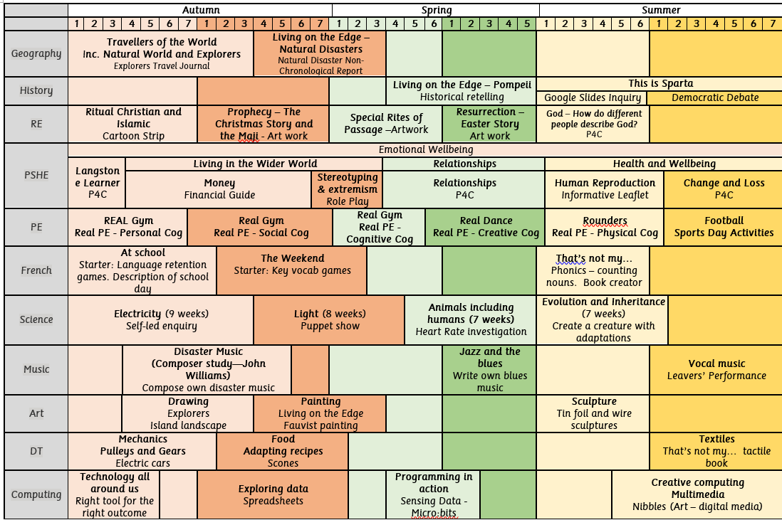
Year 6 Subject Overviews

Slide 5
Year 6 SATs
What are SATs?
The Standard Assessment Tests (otherwise known as SATs) check your child’s knowledge of the National Curriculum. The tests are compulsory for Year 6 students and they’re used to assess your child against age-related expectations. They are an opportunity for your child to demonstrate what they have learned and that they are secondary ready.
Important Dates
Autumn 1/2 mock SATs | 13th – 16th October 2025
Spring 1 mock SATs | 12th – 15th January 2026
Spring 2 mock SATs | 16th – 19th March 2026
SATs Week | 11th – 14th May 2026
Test days
Grammar, punctuation & spelling | Monday
Reading | Tuesday
Maths Paper 1 & 2 | Wednesday
Maths Paper 3 | Thursday
Please remember:
- Do not book holidays on the dates above. The mock assessments are important as they allow children to familiarise themselves with the process and to build their confidence when approaching independent assessments in preparation for secondary school. They also allow teachers the opportunity to identify specific gaps and support your children to close them.

Slide 6
Enrichment – trips, workshops and special days
Term | Activity
Autumn | Reverend Visit (RE)
Autumn | HSBC finance workshop (PSHE)
Autumn | Harvest Festival
Autumn | Show Racism the Red Card Day
Autumn | Trip to Baffin’s Pond
Autumn | STEM Light workshop
Autumn | Anti-bullying week
Autumn | Careers in the Digital Sector workshop
Spring | Mosque visit (RE—Islam)
Spring | City Life Church visit (RE – Christianity)
Spring | Safer Internet Day
Spring | Children Mental Wellbeing Week
Spring | World Book Day
Summer | Times Table Rock Star Day
Summer | Ancient Greeks workshop (History)
Summer | Mental Health Week
Summer | Arts Week
Summer | Fairthorne Residential/Non - Fairthorne activities
Summer | Food workshop provided by Caterlink
Summer | School’s Diversity Day

Slide 7
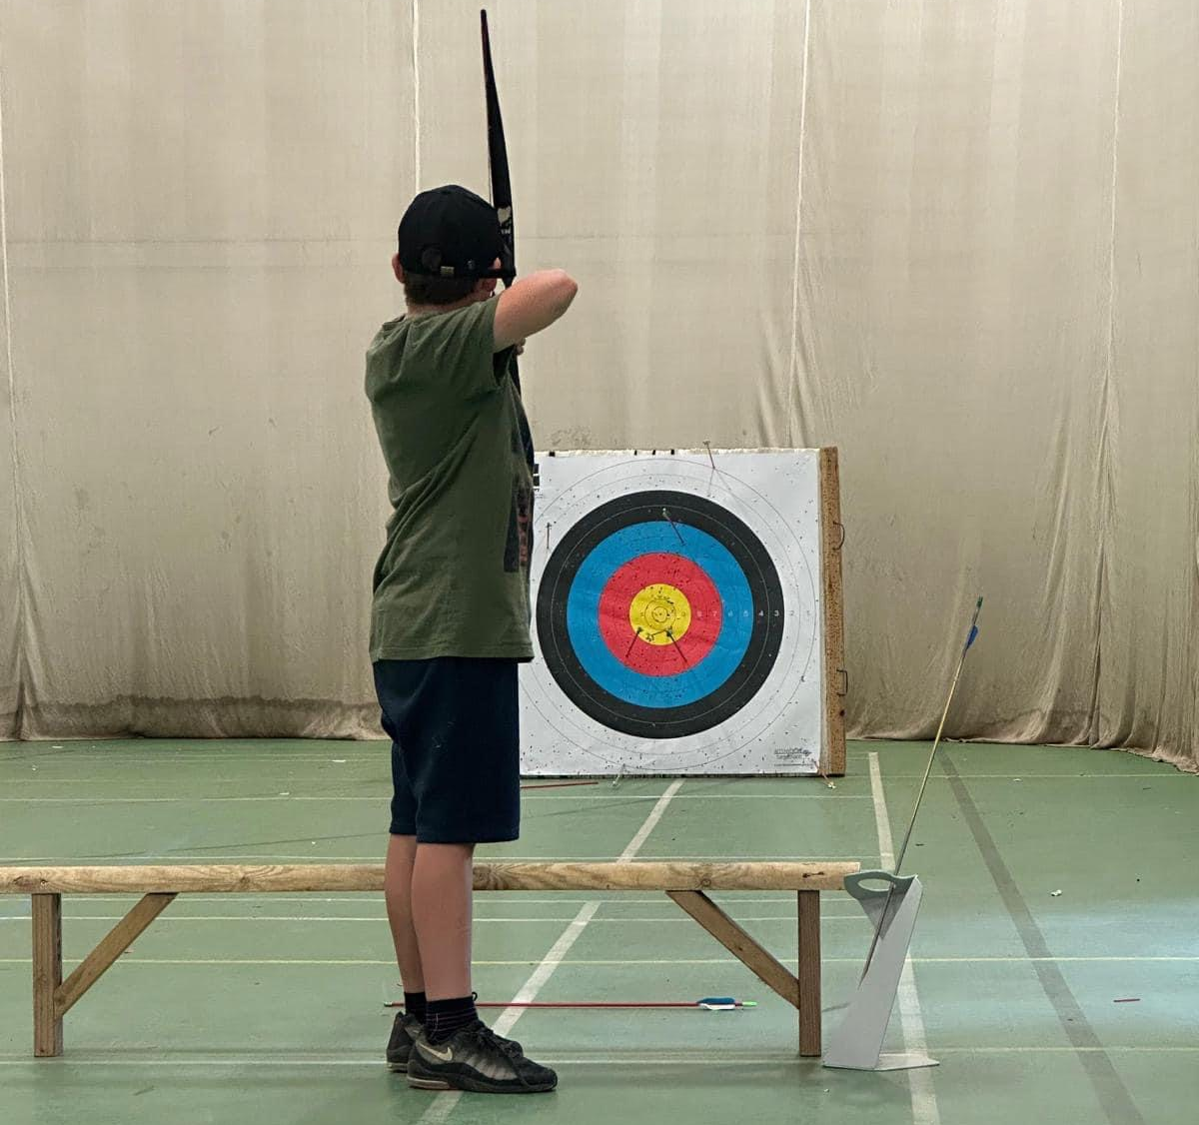
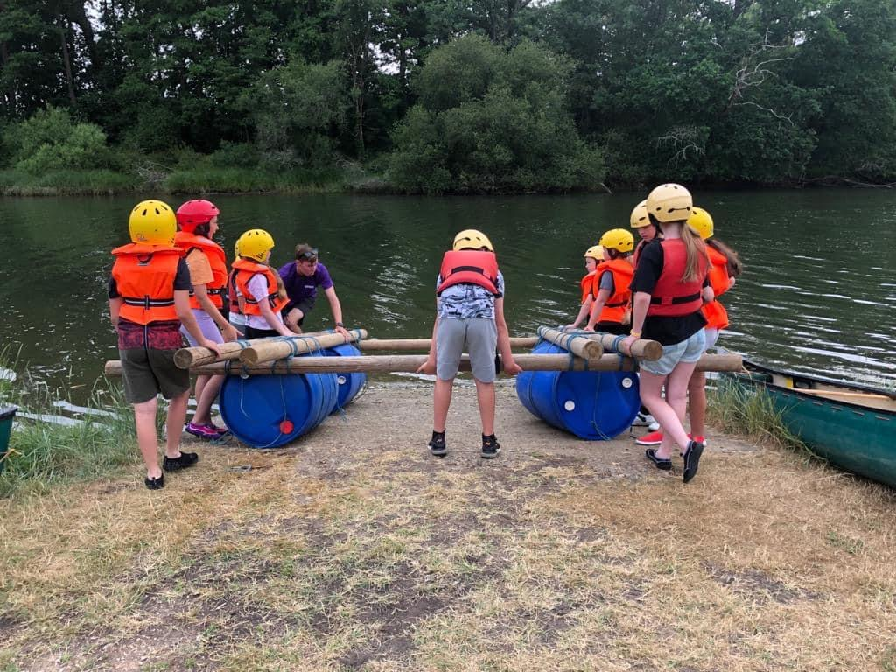
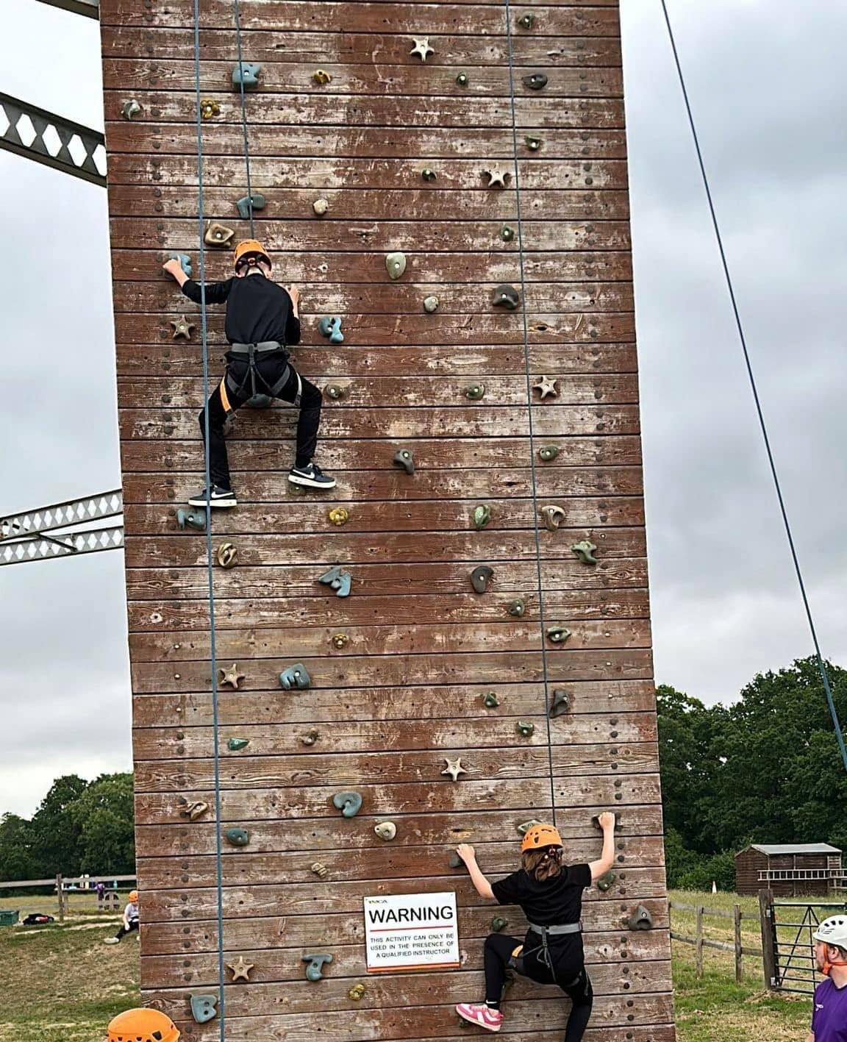
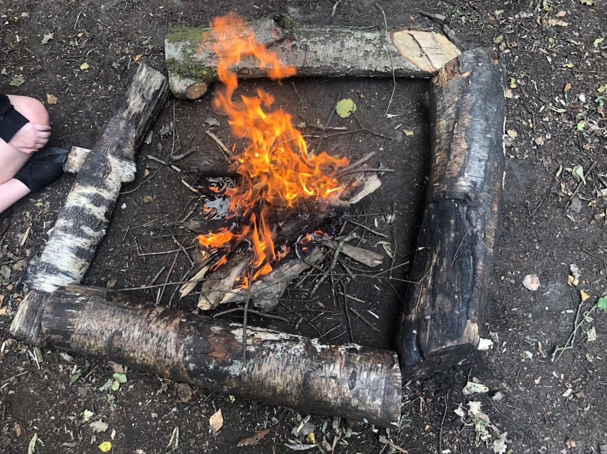
Fairthorne Residential
When is the residential?
Dates: 22nd – 26th June 2026
Leaving school: approx. 10am
Arriving back: approx. 2pm
How much does it cost?
Total price including transport, accommodation, meals and activities: £368
Deposit (£45) due: Friday 26th September 2025
Final cost due: Monday 9th March 2025
Activities we have done previously: abseiling, climbing, blind train, kayaking, canoeing, paddle boarding, high ropes, Jacob's ladder, axe throwing, archery, campfire
Activities will be confirmed closer to the time.

Slide 8


PE
PE is on Monday and Tuesday
Please arrive at school in your PE kit and remain in this for the day.
Tuesday is Indoor PE.
Monday is Outdoor PE.
PE uniform for Real Gym (Tuesday):
Black shorts, leggings or ‘skins’
White t-shirt
No shoes or socks
NO tracksuit bottoms or sweatshirt to be worn during the lesson although they can be worn to school.
PE uniform for outdoor PE (Monday):
Black shorts, leggings or ‘skins’
White t-shirt
Black tracksuit bottoms
Black jumper
Please remember:
- No jewellery can be worn during PE sessions, this includes any earrings, even studs. If your child cannot remove their own stud earrings for these sessions, please do not send them into school wearing them on their Real Gym days.
-Watches must not be worn so we ask you not to send your child in with a watch on their PE days.

Slide 9

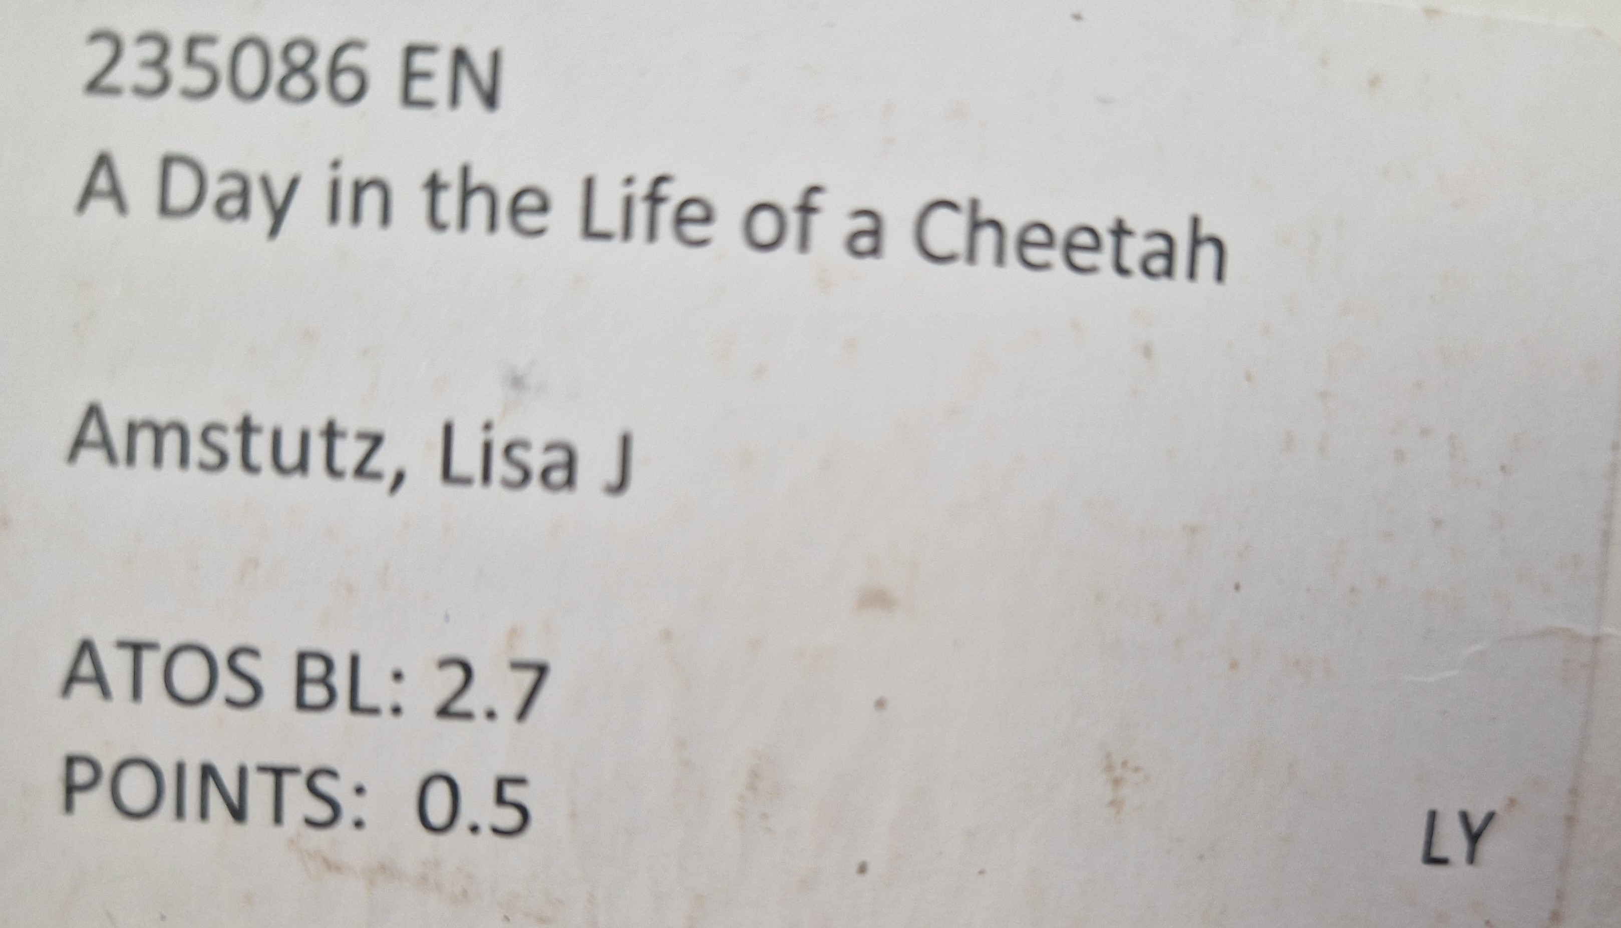
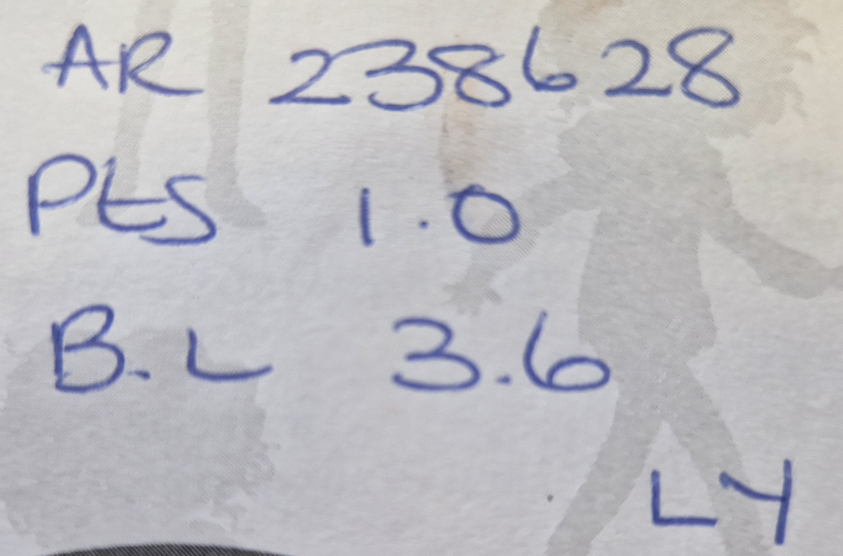


Home learning
Activity
Daily reading | Regular reading of a variety of genres is an integral part of the curriculum and develops a range of skills that children can utilise on a daily basis. We expect children to read regularly and aim for at least 5 times a week. When your child finished a book, they can complete a quiz using Accelerated Reader (https://ukhosted105.renlearn.co.uk/6708094/). The quiz number can be found inside the front cover of the book and may look like this: Your child can also access a variety of eBooks which they can read independently or be read to them at: https://www.myon.co.uk/login/ Myon uses the same username and password as Accelerated Reader.
Daily times tables practice | This could be chanting, rapid recall or quick fire questions with a family member, use of Times Tables Rockstar (https://ttrockstars.com/) or playing different times tables games. By the end of Year 4, Government expectations are that children will have rapid and fluent recall of all of their times tables up to 12 x 12.
Spellings | We expect children to learn the Year 6 National Curriculum spellings and each week, spelling homework will be sent out to help them practise. In addition, they will be tested on them at the end of each half term.

Slide 10
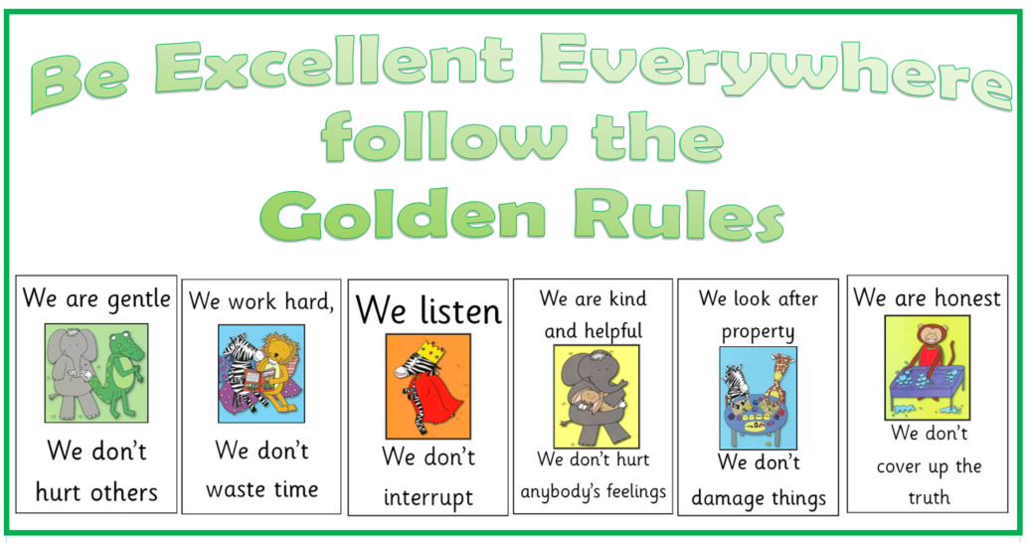
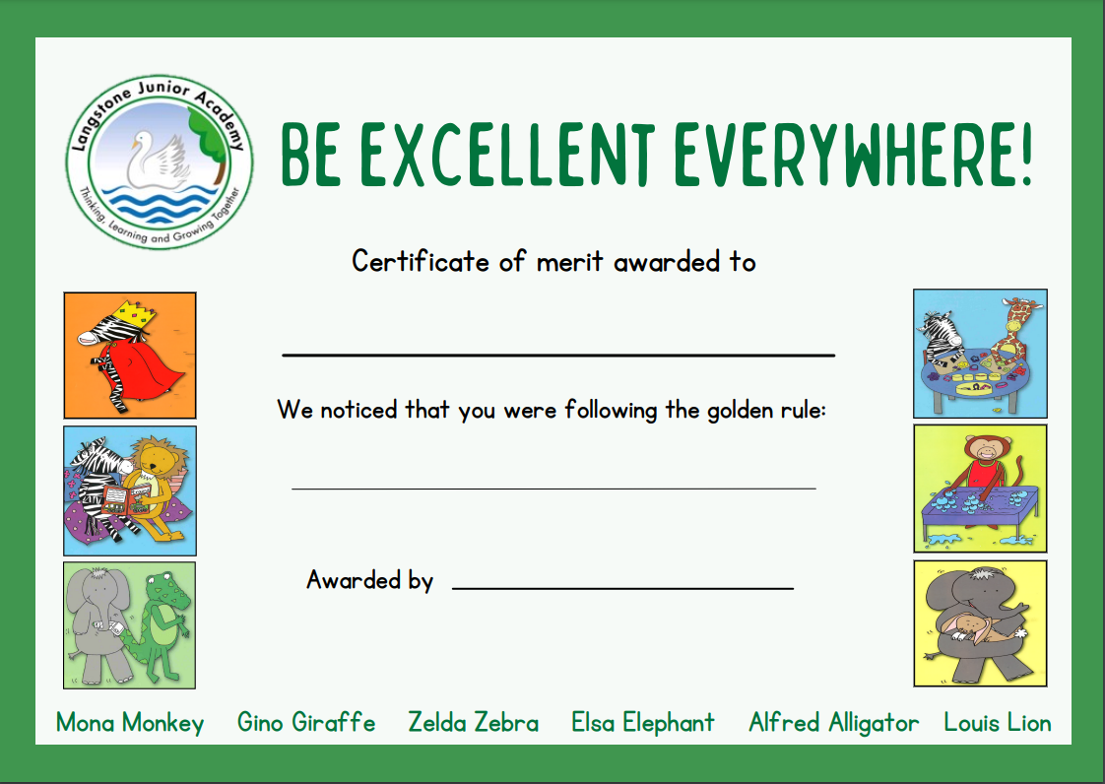
Golden Rules
At Langstone, we follow the 6 Golden Rules to make our school a safe and happy environment.
In celebration assembly, we celebrate children who have demonstrated these skills.

Slide 11



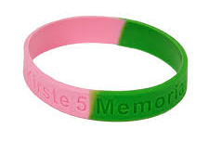
Langstone Learners
What is the Langstone Learner Award?
At Langstone Primary Academy, we are proud to have created and continue to promote our ‘Langstone Learner Award’. We aim to develop learners who are reflective, resilient thinkers and challenge themselves in all areas of learning both in and out of school.
The Langstone Learner award is a three-tiered system which empowers children to recognise and develop a set of progressively challenging skills as they develop as independent learners.
Tier
TIER 1 | ALL NEW CHILDREN TO THE SCHOOL (8 SKILLS PER AREA = 24 SKILLS) | The class teacher will observe these learning behaviours over a period of time and when evidenced consistently, will discuss this with the child and a sticker added to show achievement.
TIER 2 | TYPICALLY YEAR 4 BUT PROGRESSION WHEN APPROPRIATE FROM TIER 1 (5 SKILLS PER AREA = 15 SKILLS) | The children begin to record evidence of them meeting a skill, supported by an adult to begin with. Each skill has room to record evidence underneath. There are also additional pages in the booklet for this if needed.
TIER 3 | TYPICALLY YEAR 5 BUT PROGRESSION WHEN APPROPRIATE FROM TIER 2 (4 SKILLS PER AREA = 12 SKILLS) | The children independently record evidence of them meeting a skill. Each skill has room to record evidence underneath. There are also additional pages in the booklet for this if needed.
MASTER LEARNER | AWARDED UPON COMPLETION OF ALL THE TIERS IN ALL 3 AREAS – THINKING, RESILIENCE AND REFLECTIVENESS.
Once a tier has been achieved, you will be invited to a special celebration assembly held twice a half term. Invitations will be sent via Parentmail once the tier has been validated by the Year Leader. In this assembly, your child will be awarded with a band which corresponds with the Tier they have completed. If they have achieved all three tiers, they are now a master learner and will also be awarded with a grey ‘Master Learner’ t-shirt which can be worn in place of their normal white uniform top.

Slide 12
Class Assemblies
Each year we would like to welcome families in to watch their child in a class assembly.
This is a chance for your child to share some of their learning and practice the key skills of performing.
Assemblies take place at 8:50. If you wish to attend, please enter through our school office 10 minutes before the start time to allow time to sign in.
Class | Date
6JH | Tuesday 18th November
6AH | Tuesday 25th November
6J | Tuesday 2nd December

Slide 13
Useful websites to use at home
Accelerated Reader | https://ukhosted105.renlearn.co.uk/6708094/
Times table Rockstar | https://ttrockstars.com/
Sumdog (maths games) | https://www.sumdog.com/en/
Spelling Shed | https://www.spellingshed.com/en-gb/
Myon (reading) | https://www.myon.co.uk/index.html

